Slide 1
Trial processes & procedures

Slide 2

Screening/enrolment
Consent pathways
Eligibility and randomisation
Choice of milk & adherence to feeding
Schedule of assessments & data collection
Safety reporting & monitoring
Roles and responsibilities
Main Menu
Notes:
This section of the feed1 training package will go into a little more depth regarding the processes and procedures of the trial. You can navigate through this presentation in the standard way, or, you can click on an individual section in this contents page to move straight to that section.

Slide 3

Patient Screening/Enrolment Log
Screening/enrolment log (monthly upload)
Trial database (real time)
Notes:
There is an in depth screening pathway for the feed1 trial. It is important to the validity of the trial results that we are able to account for as many of the infants born between 30+0 and 32+6 weeks gestation across our recruiting centres as possible. The top line of the CONSORT will therefore be the total number of infants born with the target gestation. The areas of this CONSORT highlighted in yellow are prior to consent being obtained, for this reason we will be asking for a summary of numbers only for these sections. For those areas post-consent, highlighted in blue, we will be asking for more detailed information on an infant level within the database.

Slide 4
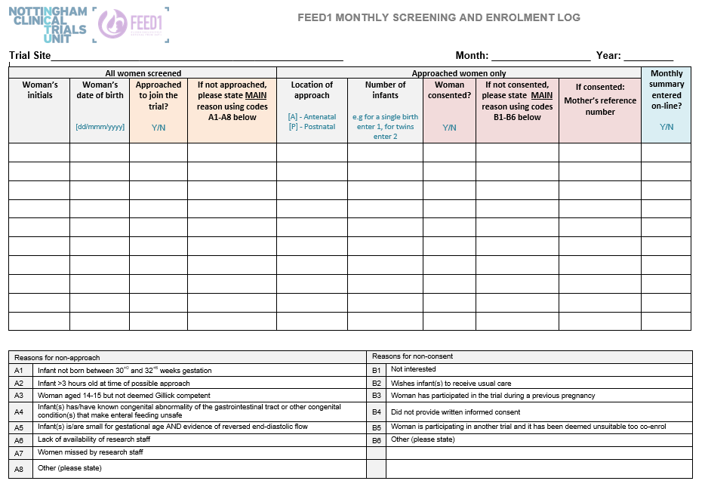
Patient Screening/Enrolment Log
Notes:
Here you can see an example of the paper screening and enrolment log. You should create a separate screening form for each month.
Throughout the month:, you should record details of all women and infants screened for trail suitability (either antenatally or postnatally), detailing the reasons for any women who were not approached or not consented
At the end of the month, please check your local systems for any infants born within the target gestation who have not yet been added to the log.
A summary of the information from this form should be uploaded to the database at the end of each month

Slide 5
Recruitment
2088 infants to be recruited within 36 months
40 research sites
Equal targets – Approximately 50 infants per site
1-2 infants per month per site
Notes:
The FEED1 trial aims to recruit 1770 women across a 36 month period, which based on the expected number of multiple births should equate to 2088 infants.
We plan to include 40 participating sites across the UK, giving each site a target of approximately 50 infants, or 1-2 per month.

Slide 6
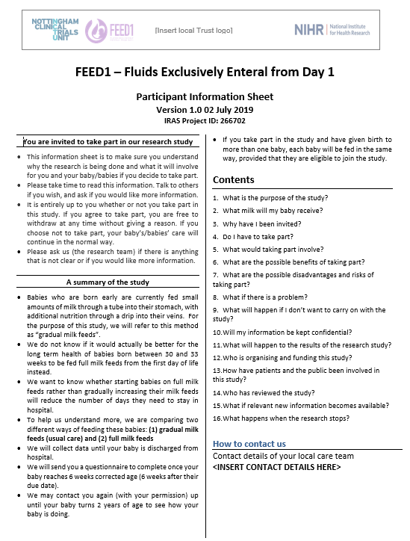

Patient Information
Patient Information Sheet
(4 pages)
Patient Information Flyer
(1 page)
Notes:
There are 2 different patient information sheets to be used for the FEED1 trial, each has it’s own purpose depending on the specific consent pathway in which the woman is being approached.
The 4 page Patient Information Sheet is the more routine document that you are used to seeing in the majority of trials. This document contains detailed information on all aspects of the trial and has been designed to support the fully informed written consent pathway.
The 1 page short information flyer contains all key aspects of the trial, however this time in a summarised format. This document has been designed to support the oral assent discussion for women who are presenting in preterm labour or have just given birth within the target gestation.
You can find out more about the consent pathways in the next section of this presentation.

Slide 7
Return to main menu
Proceed to Consent Pathways

Slide 8
Consent pathway
Information publicising the trial available in antenatal clinics, wards, neonatal unit
Antenatal written informed consent
from women
expected to deliver at
30⁺⁰ to 32⁺⁶ weeks gestation
Trial information given to women who may deliver at 30⁺⁰ to 32⁺⁶ weeks gestation during antenatal counselling
Women presenting in preterm labour (antenatal) or who has just delivered (postnatal) at 30⁺⁰ to 32⁺⁶ weeks gestation
Women willing to give antenatal written consent
No
Infant meets eligibility criteria?
Treat as per local standard care
Yes
Infant delivered at 30+0 to 32+6 weeks gestation
Mother gives oral assent
No
Infant meets eligibility criteria?
Yes
Treat as per local standard care
Treat as per local standard care
No
Yes
Randomisation within 3 hours of birth
Written informed consent as soon as possible to for use of data in trial
Notes:
There are two consent pathways in the FEED1 trial.
The first, is the antenatal written informed consent pathway. Here, women who are expecting to deliver early (and therefore may deliver within the target gestation) are approached during antenatal counselling. These women should be given the full 4-page Information Sheet in order for them to consider participation.
Women who do not give their consent should be treated as per your local routine practice. For those who give their consent, and who deliver within the target gestation, their infants will be assessed for eligibility post-birth. Any infants who are not eligible should be treated as per local practice, whilst those who are eligible will be randomised into the trial.
It is important to note that there is no requirement to re-confirm consent prior to randomisation, and therefore any eligible infants should be randomised unless the mother has explicitly stated otherwise.
For multiple births where not all infants are eligible, those who do meet the criteria should still be randomised.

Slide 9
Antenatal written consent pathway (ii)
Investigator and woman should both sign and date the Written Informed Consent form at the time of the discussion.
Enter woman’s details into the randomisation database.
Once woman gives birth, the database can be accessed again and infant eligibility can be checked.
Eligible infants of women who have provided antenatal written consent will be randomised into the trial unless the woman explicitly withdraws her consent.
Notes:
Both the consenting investigator and the woman should sign and date the consent form at the time of the discussion.
Once written informed consent has been obtained antenatally, the woman’s details should be added to the trial enrolment database, this will allow for the close monitoring of all women with antenatal consent in place at your site and will clearly display the current gestation of each women. It is advised that site staff review this list on a regular basis, to build an awareness of which women are within the target gestation at any given time in order to minimise the risk of infants being missed.
Once the woman gives birth, the database can be accessed and the infants eligibility can be entered and checked. Eligible infants can then be randomised.
There are only 3 hours in which to randomise the infants after birth, by ensuring that the enrolment data for women who are consented antenatally is entered at the time of consent rather than waiting for them to deliver, the amount of data entry required in the time-critical period post-birth is greatly reduced.

Slide 10
Consent pathway
Information publicising the trial available in antenatal clinics, wards, neonatal unit
Oral assent followed by
deferred written informed consent from women
presenting in preterm labour
or who have delivered at
30⁺⁰ to 32⁺⁶ weeks gestation
Trial information given to women who may deliver at 30⁺⁰ to 32⁺⁶ weeks gestation during antenatal counselling
Women presenting in preterm labour (antenatal) or who has just delivered (postnatal) at 30⁺⁰ to 32⁺⁶ weeks gestation
Women willing to give antenatal written consent
No
Infant meets eligibility criteria?
Treat as per local standard care
Yes
Infant delivered at 30+0 to 32+6 weeks gestation
Mother gives oral assent
No
Infant meets eligibility criteria?
Yes
Treat as per local standard care
Treat as per local standard care
No
Yes
Randomisation within 3 hours of birth
Written informed consent as soon as possible to for use of data in trial
Notes:
The second consent pathway is the oral assent pathway, which is to be used for women either presenting in preterm labour or who have just given birth within the target gestation. Should the infants be eligible, they can be randomised to the trial once oral assent has been obtained.
Written informed consent should be taken at a later time point, when it is felt that it is appropriate to do so.

Slide 11
Antenatal/postnatal oral assent pathway
Clinician / Research Nurse to speak with the women about the trial. The short Patient Information Flyer can be used to facilitate discussions.
Investigators must be sure that the woman has a clear understanding of the trial.
A verbal confirmation from the woman (oral assent) is sufficient at this stage.
Investigator and a witness must document the oral assent in section B of the Informed Consent Form
Notes:
For the oral assent process, the attending clinician or research nurse should discuss the trial with the woman. We have provided a short information flyer that can be used to support this discussion if necessary. It is vital to ensure that the woman has a clear understanding of the trial.
There is a separate section of the informed consent form in which to document the oral assent discussion. This must be signed by a witness. Although this must be a healthcare witness rather than a friend or relative of the women, the witness does not need to be trained or delegated any FEED1 duties, they are purely signing to confirm that the discussion took place.

Slide 12
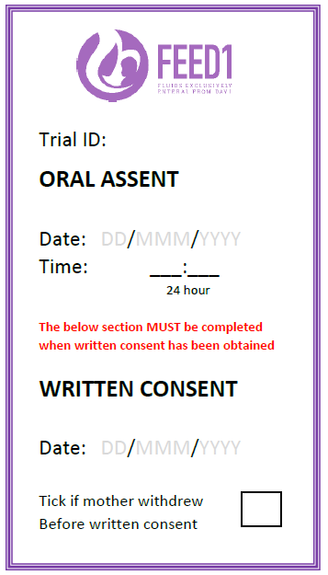
Oral assent sticker
To be applied to medical notes of women who have provided oral assent
A reminder that written informed consent should be obtained as soon as possible (when deemed appropriate)
Written informed consent to be obtained within 72 hours of oral assent where possible.
Notes:
You have been provided with a set of oral assent stickers within your site file. The use of these stickers is not compulsory, however you may wish to attach them to the medical records of mothers who have given their oral assent, as a reminder that full written informed consent is outstanding.

Slide 13
Consent pathway
Information publicising the trial available in antenatal clinics, wards, neonatal unit
Trial information given to women who may deliver at 30⁺⁰ to 32⁺⁶ weeks gestation during antenatal counselling
Women presenting in preterm labour (antenatal) or who has just delivered (postnatal) at 30⁺⁰ to 32⁺⁶ weeks gestation
Women willing to give antenatal written consent
No
Infant meets eligibility criteria?
Treat as per local standard care
Yes
Infant delivered at 30+0 to 32+6 weeks gestation
Mother gives oral assent
No
Infant meets eligibility criteria?
Yes
Treat as per local standard care
Treat as per local standard care
No
Yes
Randomisation within 3 hours of birth
Written informed consent as soon as possible to for use of data in trial
Notes:
Irrespective of the pathway in which the woman is entered into the trial, it is critical that the infants are randomised within 3 hours of birth. This not only helps to ensure that the trial feeding regime, be it routine care or the FEED1 intervention, is started as soon as possible, but also minimises the number of painful procedures, such as cannulas, that infants in the intervention arm are exposed to.
It is important to note that if an infant has been started on IV fluids, this does not effect their eligibility to participate in the trial.

Slide 14
Intervention
Randomise mother within 3 hours of birth
Intervention (full milk)
Total enteral milk feeds from day 1
60ml/kg/day, increasing as per daily fluid requirement up to at least 140ml/kg/day
Control (gradual milk)
IV fluid or parenteral nutrition
milk maximum of 30ml/kg milk on day 1, then increase as per local practice
Increase milk feeds, add breast milk fortifiers, or other changes as per local practice.
Feeding data collection until 140ml/kg/day reached and sustained for 3 days
Data collection until baby is discharged home
6 week corrected gestational age – questionnaire for health economic data
Ongoing contact with families to facilitate planned two year follow-up
Notes:
Infants will be randomised in a 1:1 ratio to either the intervention or the control arm of the trial.
Those in the intervention arm should be started on full milk feeds at a minimum of 60ml per kg per day, increasing as per their fluid requirements. If an infant in the intervention arm has already been started on IV fluids, then this should be stopped as soon as possible.
Those in the control arm of the trial should be started on IV fluids and parenteral nutrition, as per your local practice, with a maximum of 30ml/kg milk on day 1.
The trial has been designed to be as pragmatic as possible. With that in mind, regardless of trial intervention, feeding increments, the addition of fortifiers and any other changes should follow your local practice.
Feeding data will be collected until the infant reaches the protocol definition of ‘full feed’s, which is 140ml/kg/day for 3 consecutive days.
Further data will be collected until the infant is discharged home, with a follow-up at 6-weeks corrected age coordinated by the trial team at Nottingham CTU.
For women who have given their consent, we hope to maintain contact with their families in order to follow-up their infants development at 2 years.

Slide 15
Return to main menu
Proceed to Eligibility & Randomisation

Slide 16
Eligibility – Inclusion Criteria
Infants born between 30⁺⁰ and 32⁺⁶ weeks gestation, inclusive
Infant <3 hours (180 minutes) old
Should any Infants require respiratory support (such as via continuous positive airway pressure) or other supportive treatments they can be included in the study, if the attending clinician is in equipoise about the infant being randomised to either the ‘full milk’ or ‘gradual milk arm’.
Mother’s aged 14 and 15 can be included in the trial if the consenting investigators has assessed the mother and deemed that she is Gillick Competent prior to inclusion.
Notes:
Infants are eligible for the FEED1 trial if they are born within 30+0 and 32+6 weeks gestation and are less than 3 hours of age. There are no restrictions for infants receiving any form of respiratory support, providing the assessing clinician is in equipoise about the infant receiving either routine care or the intervention.
Infants of women aged 14 or 15 can be included in the trial if the women is deemed to be Gillick competent.

Slide 17
Eligibility - Exclusion criteria
Any Infant with known congenital anomalies of the gastrointestinal tract or other congenital conditions that make enteral feeding unsafe
Infants who are small for gestational age (birth weight <10th centile) AND evidence of reversed end-diastolic flow on antenatal umbilical artery Doppler ultrasound*
Mother has participated in the trial during a previous pregnancy#
* Small for gestational age infants with antenatal Doppler ultrasound scan showing absent umbilical artery flow or whose mother’s did not have antenatal umbilical Doppler ultrasound may be eligible for the trial if they meet the other inclusion criteria
# To avoid bias due to the experience of previous participation.
Notes:
Infants are excluded from participation if they have any anomalies that make enteral feeding unsafe. The second exclusion is a composite. Infants who are BOTH small for gestational age AND have evidence of reversed end-diastolic flow must be excluded from the trial. For infants where there was no umbilical Doppler ultrasound, these can be considered as having no evidence of reversed end diastolic flow and can therefore be included in the trial.
Given the length of the recruiting period and the short target gestation, it is possible that women may present during a second or more pregnancy. Due to the risk of bias from previous experience, women who have participated during a previous pregnancy should be excluded.

Slide 18
Equipoise
“A true state of equipoise exists when one has no good basis for a choice
between two or more care options.”
Important that clinicians are in equipoise
We do not know whether starting infants born between 30⁺⁰ and 32⁺⁶ weeks gestation will be of benefit
That is why we are conducting the trial!
Notes:
Regardless of the inclusion and exclusion criteria outlined in the previous slides, it is critical that infants are only included in the trial if the assessing clinician is in equipoise. This means, the clinician should be in a position where they do not know feel strongly that the infant should be fed by either of the feeding regimes in particular.

Slide 19
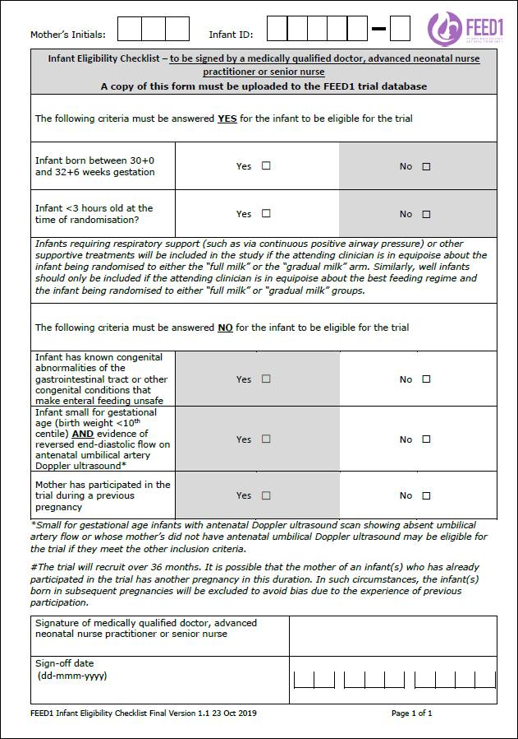
Eligibility assessment
Infant eligibility must be assessed by a medically qualified doctor, advanced neonatal nurse practitioner or senior nurse
The person assessing eligibility must sign and date the eligibility checklist
Eligibility checklist to be filed in the ISF.
Notes:
Infant eligibility must be assessed by either a medically qualified doctor, an ANNP or a senior nurse. Local policies should depict those staff who constitute a senior nurse. A separate eligibility checklist must be signed for each infant included in the trial, and these should be filed in the site file.

Slide 20
Randomisation
Via an electronic database.
The unit of randomisation is the Mother.
Entering of the mothers’ details into the trial randomisation database in the following way is required:
  Woman’s NHS number entered first
  If woman has been approached and consented previously (e.g. antenatally) the database will direct to the woman’s details
  After entering the maternal enrolment details, infant eligibility (for each infant) must be entered prior to randomisation.
  Randomisation must be completed within 3 hours of birth.
  For women who are enrolled into the trial but are not randomised, reasons for not randomising will be captured on the enrolment database.
Notes:
Following work that was carried out with our parent representatives, it was clear that it is important to mothers that each of their infants are treated in the same manner, for this reason the unit of randomisation is the mother. This ensures that siblings in multiple births are randomised to the same feeding regime.
Randomisation is carried out via an online database, with the NHS number entered first to mitigate the risk of mothers being entered more than once. Eligibility questions must be answered for each infant that you wish to include in the trial before proceeding to randomising. Randomisation cannot be completed should an infant pass 3 hours of age.

Slide 21
Return to main menu
Proceed to Choice of milk & adherence

Slide 22
Choice of milk
Mother’s own breast milk – ALWAYS the first choice
Volume supplemented with preterm formula or donor breast milk* as per mother’s choice, site usual practice and attending clinician’s advice
Supplemental milk used only when volume of mother’s own milk is not sufficient and will be discontinued as soon as sufficient volume of mother’s milk if available such that supplemental milk replaces intravenous fluids or parenteral nutrition only.
*if a site does not use donor breast milk currently, but is interested in setting up a service then the trial team are able to provide a contact at the Human Milk Foundation
Notes:
Mother’s own breast milk should always be the first choice.
It is unlikely that women who give birth at the target gestation will initially produce the quantities required for the full milk arm of the trial. Volume will be supplemented with either preterm formula or donor breast milk, depending on mother’s choice, site practice and the clinicians advice.
Supplemental milk should only be used to replace IV fluids or parenteral nutrition and not mother’s own milk.

Slide 23
Adherence
Adherence data will routinely be reviewed by the Trial Management Group.
Adherence by those randomised to full milk feeds is defined as having received ≤24 hours IV fluids or parenteral nutrition from birth to achieving full milk feeds (defined as at least 140 ml/kg/day for three consecutive days).
Adherence by those randomised to gradual milk feeds is defined as having received >24 hours IV fluids or parenteral nutrition from birth to achieving full milk feeds (defined as at least 140 ml/kg/day for three consecutive days).
Notes:
Adherence to the allocated feeding regime will be closely monitored.
Those randomised to the full milk arm should receive less than or equal to 24 hours of iv fluids or parenteral nutrition from birth to reaching full feeds. Those in the routine arm are expected to receive greater than 24 hours of IV fluids or parenteral nutrition.
The health and safety of the infants is of course paramount. Any required feeding adjustments should be made as per the infants needs and as advised clinically, and must not be dictated in any way by the FEED1 intervention. It is important to record all feeding data accurately so that any adjustments made to feeding allocations can be accounted for in the trial analysis.

Slide 24
Return to main menu
Proceed to Schedule of assessments & data collection

Slide 25
Schedule of assessments (i)
≤3 hours after infant(s) birth:
Obtain oral assent for women recruited via the postnatal pathway
Check eligibility criteria
Collection of mother and baby demographic data
Randomise mother into the trial and inform family of allocation for their infant
Notes:
Infants must be randomised within 3 hours of birth.
For some women, you will have already taken full written informed consent antenatally, otherwise, oral assent should be taken prior to any trial related activity taking place.
Each infant must be assessed for their eligibility for the trial prior to randomisation, with the eligibility checklist being completed and signed as evidence.
There is a small amount of data that is required in order to complete the randomisation process, such as eligibility data and data required for balancing the trial arms.
Once this has been obtained, the mother can be randomised and all eligible infants will be entered into the trial.

Slide 26
Schedule of assessments (ii)
Post-randomisation
For infants in the INTERVENTION arm start full milk feeds at 60ml/kg/day
For infants in the CONTROL arm start IV fluids and/or parenteral nutrition and gradual milk feeds as per usual local practice
For those who have given only oral assent, remember to obtain written informed consent as soon as it is appropriate to do so – within 72 hours where possible.
Notes:
As soon as possible after randomisation, infants in the intervention arm should be started on full milk feeds. For infants in the control arm, IV fluids and parenteral nutrition should continue as per local practice.
For infants who are entered into the trial via the oral assent pathway, it is important to obtain full written informed consent as soon as it is suitable to do so. The suggested timeframe for this is within 72 hours, however we accept that this may not always be appropriate.
It is important to note that you will be unable to enter any data into the electronic CRF until written informed consent has been recorded.

Slide 27
Schedule of assessments (iii)
Daily feed log – until infant receives full feeds (140ml/kg/day feeds, sustained for 3 days)
  Total volume of feeds
  Volume of each type of milk
  Methods of feeding
  Use of parenteral nutrition/IV fluids
  Number of intravenous cannula or central venous lines inserted on the day
  Record of any administered antibiotics or antivirals
  Record of any measured blood glucose levels
  Record of any feeds withheld for more than 4 hours
Notes:
The most labour intensive part of the data collection process is the daily feeding log.
In order to simplify the process, we advise that you follow your local feeding log timelines. This may mean that the first day of feeding data is less than 24h, this has been accepted by the trial team. For example, if your local feeding logs run from midnight to midnight then the first day in FEED1 feeding data will be from the time of birth until midnight. Day 2 will start in line with your local logs.
The daily feeding log should be completed until the infant reaches the protocol definition of full feeds and will capture data on the volumes and types of milk given, the feeding methods, any painful procedures and data to monitor for any occurrence of sepsis, necrotising enterocolitis or hypoglycaemia.

Slide 28
Schedule of assessments (iv)
Further daily data required for secondary outcomes – data collection form is OPTIONAL as an aide memoire
Date when infant first met all three criteria below:
  Reached ≥1700g
  Was able to take at least one full suck feed in the last 24 hours
  maintained body temperature without additional temperature support for at least 24 hours
Number of days parenteral nutrition was received during admission
Number of days central lines we used during admission
Number of central lines inserted during admission
Notes:
There are further daily data points that are required to answer important secondary outcomes. We have provided a data collection sheet for this, however this is to be used as an aide memoire and does not need entering into the electronic CRF on a daily basis.
If you are confident in answering the questions outlined on this slide from routine sources at discharge, then you need not use this daily collection sheet.

Slide 29
Schedule of assessments (v)
Survival to discharge (death on the neonatal unit)
  reported as a Serious Adverse Event.
  The date and cause of death recorded on the ‘Death Form’ of the CRF.
  Death after hospital discharge
  A search of hospital records at 5 weeks corrected age
  For any infants who have died, the investigators should provide the date and cause of death, where possible.
Notes:
Other important outcomes include those who have passed away during their hospital stay, and those who pass away after discharge.
Any instances of death should be reported as a serious adverse event, within 24 hours of becoming aware of the event. There is also a ‘Death form’ within the eCRF that should be completed in order to provide the cause of death.
You will be required to carry out a wellbeing check on all infants once they reach 5-weeks corrected age in order to capture any deaths after discharge.

Slide 30
Schedule of assessments (vi)
Hospital discharge (discharge form in the CRF)
  Weight and head circumference
  Types and modes of feeding (including discharge on nasogastric feeding)
  Need for home oxygen therapy
  Results of retinopathy of prematurity screening, if performed.
Notes:
At discharge, you will be asked to report on the infants weight and head circumference, from which we will calculate the z-scores. It is understood that head circumference is not always recorded at discharge, however we ask that you work with your local teams in order to try to ensure that this is carried out.
We will also ask for data on the types and modes of feeding at discharge and any need for home oxygen. You should report any results of retinopathy of prematurity screening, if this took place, however we do not expect this screening to be performed purely for the purposes of the trial.

Slide 31
Schedule of assessments (vii)
Additional data entered into the randomisation database. This can be entered at any time before discharge.
  Mother’s demographic information
  Infant NHS number and first name
  Mother’s contact information
  (including secondary address where possible)
Notes:
There are additional data fields that are required in order to facilitate the follow-up process. We ask that these are entered into the database no later than the time of hospital discharge.

Slide 32
Schedule of assessments (viii)
6-weeks corrected age questionnaire - Mother sent a questionnaire (either postal or online as per mother’s preference) to collect data on:
  Types and modes of feeding at 6 weeks corrected age
  Infant health care visits
  Use of other health care resources
  Parental satisfaction and wellbeing using the p-BESS questionnaire
coordinated centrally by the NCTU.
5 week corrected age checks to be completed by the investigator (or delegate), with a confirmation of infant status (living or died) provided via a report in the trial database
Mothers of infants who have died will be sent an appropriately adjusted 6-week questionnaire and accompanying letter.
Notes:
Mothers will be sent a follow-up questionnaire at 6-weeks corrected age. Although this can be completed either online or via post, in order to streamline the data collection process and to reduce the administrative burden we ask that you obtain an email address from all mothers in order for questionnaires to be delivered online where possible.
Follow-up will be coordinated centrally by Nottingham Clinical Trials Unit.
The role of site staff will be to complete a wellbeing check on all infants once they reach 5-weeks corrected age, this will allow us to adjust the follow-up questionnaire and accompanying letter should any infants have passed away.

Slide 33
Late-onset invasive infection (LOS) (i)
A record of any diagnoses of microbiologically-confirmed (positive blood/CSF culture) or clinically-suspected late-onset sepsis.
Each episode to be entered into the LOI form on the electronic CRF
All reports of LOS must be reviewed and signed electronically by the PI
Notes:
For infants with either microbiologically-confirmed or clinically-suspected sepsis, a Late Onset Infection form should be completed within the electronic CRF. Each episode requires electronic sign-off by the Principal Investigator.
Definitions for both microbiologically-confirmed and clinically-suspected sepsis are shown on the next two slides.

Slide 34
Late-onset invasive infection (LOS) (ii)
Definition of Microbiologically-confirmed Late-onset Invasive Infection
A modified version of the UK Neonatal Infection Surveillance Network case-definition will be used:
Microbiological culture from blood or CSF sampled aseptically more than 72 hours after birth of any of the following:
potentially pathogenic bacteria (including coagulase-negative Staphylococci species but excluding probable skin contaminants such as diptheroids, micrococci, propionibacteria or a mixed flora
fungi
AND
Treatment for 5 or more days with intravenous antibiotics after the above investigation was undertaken. If the infant died, was discharged, or was transferred prior to the completion of 5 days of intravenous antibiotics, this condition would still be met if the intention was to treat for 5 or more days.
There is no need to report urinary tract infection unless there is also a positive blood culture.

Slide 35
Late-onset invasive infection (LOS) (iii)
Definition of Clinically Suspected Late-onset Invasive Infection
This is adapted from the European Medicines Agency consensus criteria and the predictive model.
Either – absence of positive microbiological culture OR culture of a mixed microbial flora or of likely skin contaminants (diptheroids, micrococci, propionibacteria) only
AND
Clinician intent to administer intravenous antibiotic treatment for 5 or more days (excluding antimicrobial prohylaxsis) for an infant who demonstrates 3 or more of the following clinical or laboratory features of invasive infection:
Increase in oxygen requirement or ventilatory support
Increase in frequency of episodes of bradycardia or apnoea
Temperature instability
Ileus or enteral feeds intolerance and/or abdominal distention
Reduced urine output to <1ml/kg/hour
Impaired peripheral perfusion (impaired capillary refill time >3 seconds, skin mottling or core-peripheral temperature gap >2°C)
Hypotension (clinician defined as needing volume or inotrope support)
“irritability, lethargy or hypotonia” (clinician defined)
Serum C-reactive protein levels to >15 mg/L or procalcitonin ≥2mg/ml
White blood cells count <4 or >20 X 10⁹ cells/L or platelet count <100X10⁹/L
Glucose intolerance (blood glucose <2.2 mmo/l or >10 mmol/l)
Metabolic acidosis (base excess <-10mmol/L or lactate>2mmol/L)

Slide 36
Gut-signs
A record of any “gut signs” suggesting a diagnosis of necrotising enterocolitis (Bell’s stage 2 or 3).
Each episode to be entered into the gut signs form on the electronic CRF.
All reports of gut signs must be reviewed and signed electronically by the PI.
Notes:
Similarly to the reports for sepsis, any episodes of nectrotising enterocolitis should be reported in the electronic CRF, however this time via the Gut Signs form. Each must be signed off by the Principle Investigator.

Slide 37
Data collection/entry
CRF workbooks are provided to assist with the collection of trial data.
Where data is entered directly into these (i.e. not taken from elsewhere such as medical notes), then the workbook acts as source data.
Completed workbooks MUST be retained at site.
Data should be entered into the eCRF within 7 days of collection where possible.
Notes:
The CRF for the FEED1 trial is electronic. All staff trained and delegated the role of data entry will be granted access. Paper CRF workbooks are provide as an aide memoire to assist with the data collection process, however their use is not compulsory.
Paper CRF workbooks should be retained at site as source data. For those using the workbooks, we ask that data is entered into the eCRF within 7 days of data collection where possible, to assist us with the ongoing data monitoring process and data cleaning process.
The following two slides provide the links to the randomisation database and the electronic CRF.

Slide 38
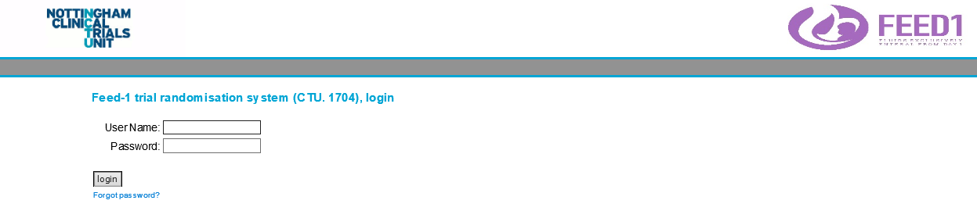
IT systems
Screening, Enrolment, Randomisation
https://ctu2.nottingham.ac.uk/1704/login.asp

Slide 39
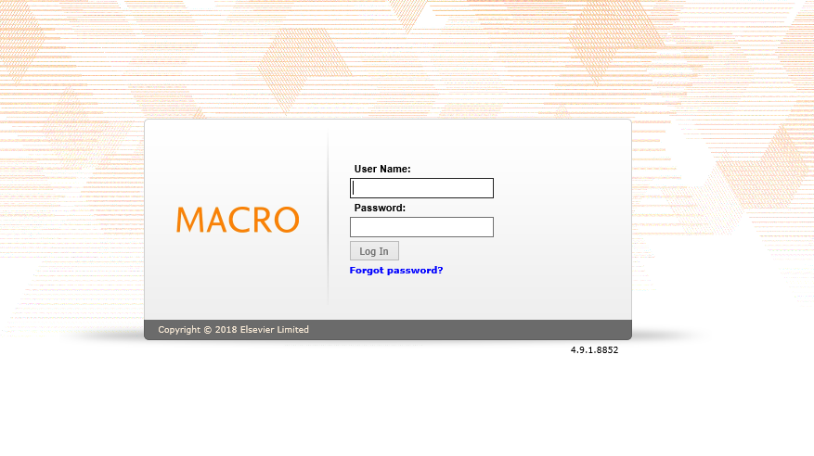
IT systems
All staff must complete a database access form
https://macro02.nottingham.ac.uk/Macro/

Slide 40
Return to main menu
Proceed to safety reporting & monitoring

Slide 41
Safety – Adverse Events (AEs)
Adverse Events (AEs) are commonly encountered in infants receiving neonatal care and will be recorded in medical notes, as per usual practice.
Adverse Reactions (ARs) are collected as outcomes for this trial and will not be reported on a separate AE CRF.
Blood glucose levels <2.2mmol/L to be reported on the hypoglycaemia form in the electronic CRF.
Notes:
Adverse events are common in infants requiring neonatal care. There is no separate adverse reaction log for this trial as these are collected as a part of the trial dataset.
There is a separate form for the reporting of any instances of hypoglycaemia, defined as a blood glucose level of less than 2.2mmol/L.

Slide 42
Safety – Serious Adverse Events (SAEs)
Investigators will report AEs that meet the definition of an SAE. An SAE is defined as an AE that meets at least one of the below criteria:
results in death;
is life-threatening;
requires hospitalisation or prolongation of existing hospitalisation;
results in persistent or significant disability or incapacity; and
consists of a congenital anomaly or birth defect.
Notes:
Please take the time to familiarise yourself with the definitions of a serious adverse event shown on this slide.

Slide 43
Safety – Serious Adverse Events (SAEs)
The Investigator (or delegate) must complete, date and sign an SAE Form. The form should arrive at NCTU by email or fax (as below) as soon as possible and no later than 24 hours after first becoming aware of the event:
To report an SAE, email the SAE Form to: nctu-sae@nottingham.ac.uk
Or fax the SAE Form to: 0115 74 84092
Notes:
SAEs must be reported to NCTU within 24 hours of becoming aware of the event. These must be submitted using the SAE form provided in your site file, via email or fax using the details shown on this slide.

Slide 44
Safety – Events that do not require reporting as SAEs
The following are regarded as expected SAEs for the purpose of trial and should not be reported on an SAE form.
Late-onset sepsis: A record of any diagnoses of microbiologically-confirmed (positive blood/CSF culture) or clinically-suspected late-onset sepsis (as per diagnostic criteria detailed in section 2.2). A ‘Late onset invasive infection’ form should be completed for each episode and entered onto the eCRF.
Necrotising enterocolitis (NEC): A record of any “gut signs” suggesting a diagnosis of necrotising enterocolitis (Bell’s stage 2 or 3). A ‘gut-signs’ form should be completed for each episode and entered onto the eCRF.
Known complication(s) of prematurity: any event that is deemed by the investigator to be a known complication of prematurity should not be reported but should be recorded in the infant’s medical notes, as per usual practice.
Notes:
There are various events that could meet the definition of a serious adverse event, that we do not require reporting as such.
Any episodes of late-onset sepsis of necrotising enterocolitis should be reported via their respective reporting forms rather than as a SAE. Given that preterm infants are at risk of various events as a complication of prematurity, we do not require such events to be reported as an SAE, these should however be recorded in the medical notes as per usual practice. It is the responsibility of the investigator to determine whether or not an event is an expected complication of prematurity.
If you are unsure whether an event needs to be reported as a SAE, then please contact the FEED1 trial team.

Slide 45
Protocol deviations
Things to report on the protocol deviation log:
Any errors in the randomisation process (e.g. incorrect weight, gestation)
If unsure, just ask!
Notes:
The CRF has been designed in a way whereby the majority of expected deviations will be captured in the data itself. Any deviations from the allocated feeding pathway need not be reported as a protocol deviation as these will be captured from the feeding log data. If there are any errors in the data that is entered for infant eligibility, prior to randomisation, then these need to be reported as a deviation as they cannot be amended post-randomisation.
If you are unsure whether or not you need to report an event as a deviation, then please contact the FEED1 trial team.

Slide 46
Source Data
Where trial workbooks are being used to collect data directly from the participant these are considered source data and must be retained (form part of patients medical history)
Site should provide “Source Data Location Log” to outline where data is anticipated to be located. A copy of this should be filed in section 3.1 of the Investigator Site File (ISF)
Documentation in Medical Records
  Copy of Informed Consent Form
  Copy of Patient Information Sheet
Notes:
It is important that source data is retained and is easily recalled if required. If your site is using the paper CRF workbooks then these should be retained, as they will constitute source data for certain data fields.
Each site must complete a Source Data Location log prior to being given the green light for recruitment to commence.
Key trial documents, such as evidence of consent and a copy of the Patient Information Sheet should be filed in the infants medical notes.

Slide 47
Infant Transfers
Complete relevant sections of the Transfer Pack and ensure that this accompanies any infants transferred to another hospital (continuing care site).
A copy of the CRF workbook should be sent in order for the receiving hospital to continue data collection. Retain the original CRF workbook at the randomising site.
Section of Transfer Pack for during transfer feeds/fluids/procedures – highlight this to the transfer team
Intervention will be continued and data collection will be completed by receiving site.
The Transfer Form in the electronic CRF must be completed. This gives details of the receiving hospital to ensure that NCTU can begin contractual arrangements and facilitate the ongoing collection of trial data.
Notes:
It is possible that infants will be transferred to another hospital whilst enrolled in the FEED1 trial. There are three crucial steps you should take in order to ensure the ongoing provision of data for these infants.
Firstly, make contact with the receiving hospital in order to identify a member of staff who is willing to provide ongoing data.
Secondly to ensure that the Transfer Pack provided accompanies any transferred infants.
Finally, the Transfer form should be completed within the CRF so that the FEED1 trial team are aware of the transfer and are able to help facilitate ongoing data collection.
These points are particularly crucial for infants who have yet to reach full feeds, as there will be a large amount of data still to collect.

Slide 48
Blinding/Unblinding
 | Blinding status
Parents and infant | Not blinded
Principal investigator and other site staff | Not blinded
Chief investigator | Blinded
Database programmer | Not blinded
Trial and data management staff | Not blinded
Trial statistician | Blinded
Members of the blinded endpoint review committee (BERC) | Blinded
Notes:
This slide shows the various people involved in the delivery of the trial, and outlines those who are either blinded or not blinded to feeding allocations. Of course, it is not possible to blind the parents of the infants or site staff to the feeding allocation, but importantly the Chief Investigator and those who are responsible for the analysis of trial data will remain blinded throughout.

Slide 49
Blinded endpoint review committee (BERC)
Completed ‘Gut Signs’ forms and completed ‘Late-Onset Invasive Infection’ forms reviewed by appropriately qualified neonatal clinicians blinded to trial feeding allocation, where needed.
Any suspected inconsistencies in reporting will be queried with the relevant Principal Investigator.
Notes:
In order to ensure robust data for important secondary outcomes, a proportion of the reports for both sepsis and NEC will be reviewed by a blinded endpoint review committee. This committee may raise any apparent inconsistencies with sites, and will discuss individual cases with Principle Investigators in order to agree a consensus where necessary.

Slide 50
Withdrawal
A mother can withdraw her infant(s) from the trial at any time
Mothers requesting to withdraw should be asked to provide a reason – she can decline to provide this
Data collected up to the point of withdrawal may still be used
Mothers should be asked if they are happy for follow-up to continue
Withdrawal should be recorded in the mother and infant(s) medical records and in the eCRF
Notes:
A mother can withdraw her infant from the trial at any time, however, given that the intervention has likely already taken place, withdrawal from the trial is unlikely to effect the treatment of the infant. It therefore is hoped that infants will remain in the trial for the provision of trial data.
For example, if an infant was randomised to receive full milk feeds and was tolerating them well, then withdrawal from the trial is unlikely to lead to the clinician reducing milk feeds and introducing IV fluids or parenteral nutrition.
This should be discussed in detail with any woman wishing to withdraw her infants, and women should be asked if they are happy for data collection to continue.
Infants should only be marked as withdrawn if the mother wishes to withdraw the consent, and no longer wishes for data to be provided.

Slide 51
PI Sign-off
PI has overall responsibility for data at site
PI must review and sign (electronically) all completed ‘gut-signs’ reports and ‘late-onset sepsis’ reports
Once the eCRF for an infant is complete (i.e. infant has been discharged and discharge form completed) then the PI must sign (electronically) to verify that the data for that infant is complete and correct
Notes:
The Principal Investigator has overall responsibility for the conduct of the trial at their site, and for the completeness and quality of the data provided. For this reason, the PI must complete an electronic sign-off of each infants CRF once data collection has been completed.

Slide 52
On-site Monitoring
The FEED1 trial has been assessed as low-risk
No routine monitoring visits
On-site monitoring visits will be carried out via a triggered approach
Triggers include (but are not limited to!):
  A high number of protocol deviations
  Poor conversion rate (screening to randomisation)
  High number of withdrawals
  Poor data quality
Notes:
The FEED1 trial has been assessed as low-risk. For this reason, there are no planned routine monitoring visits. The FEED1 trial team will monitor data centrally on a regular basis.
Should there be any apparent emerging issues at your site, the FEED1 trial team may contact you in order to arrange a monitoring visit.
Monitoring visits however need not always take place as a result of arising issues, if you or your team feel that you may benefit from an on-site monitoring visit at any time, then please contact a member of the FEED1 trial team.

Slide 53
Central Monitoring
Trial conduct monitored centrally through the use of reports assessing trial data
Sites contacted via telephone/email to address any issues/concerns/irregularities
Notes:
As stated on the previous slide, the FEED1 trial will be monitored centrally through a series of data reports. Please ensure that your data is entered in a timely manner to support this process.
Should any issues arise, then the team will contact you to ensure that they are resolved promptly.

Slide 54
Return to main menu
Proceed to safety roles & responsibilities

Slide 55
Roles & responsibilities
Notes:
The following slides outline the key roles and responsibilities for all parties working to deliver the trial. Please take the time to digest the responsibilities that are associated with your role in the trial.

Slide 56

Responsibilities
Sites:
Medical care of participants, ensuring their safety and wellbeing
Work in accordance with the approved protocol, Good Clinical Practice (GCP), UK Policy Framework for Health and Social Care Research and SOPs
Comply with all ethical and legal requirements
Ensure consistency and completeness of trial data
Keeping and retaining accurate records
Nottingham Clinical Trials Unit:
Trial management
Data management
Study oversight and monitoring
Participant follow-up
SAE handling
University Hospitals of Derby and Burton NHS Foundation Trust
Sponsor

Slide 57

Responsibilities
Principal Investigator responsibility:
Overall legal responsibility for the conduct , management and safety reporting at your site
Know the protocol
Ensure resource (staff, material, time)
Eligibility confirmation, adverse event assessments
Promoting the trial to clinical colleagues
Supporting recruitment
Responding to clinical queries
Maintenance of delegation log
  Delegating appropriate trial activities to other members of staff
  Ensuring new staff are trained properly and added to log
  Removing old staff from log (inform NCTU of any staff changes!)
Maintain accurate, complete, legible records
Safety reporting
eCRF final sign off

Slide 58
Responsibilities
PI or delegate responsibilities:
Demonstrating suitability to conduct research
Acquiring needed knowledge
Follow the protocol
Maintain site file and trial related documents
Provide clear patient information to enable informed consent
Documenting consent
Logging of all screened potential participants
Complete eCRFs in a timely manner (within 7 days)
Answer data queries (within 7 days)
Maintain good communication with NCTU
Ensuring participant’s safety and wellbeing, reporting adverse events
Prepare for monitoring visits
Manage trial amendments

Slide 59

Further information
Contact us:
feed1@nottingham.ac.uk
Twitter: @FEED1Trial
Website: www.feed1.ac.uk
shalini.ojha@nottingham.ac.uk
Twitter: @shaliniojha7
Notes:
For further information, please see other slides sets in this series. You can find out more about the trial by contacting us using the information provided on this slide.

Slide 60
Return to main menu

