Slide 1
A randomised controlled trial of full milk feeds versus intravenous nutrition with gradual feeding for preterm infants (30⁺⁰ to 32⁺⁶ weeks gestational age)
Chief Investigator: Shalini Ojha
Clinical Associate Professor of Neonatology, University of Nottingham
Consultant Neonatologist, University Hospitals of Derby and Burton
1

Slide 2
Study Updates

Slide 3
UPDATE: Substantial Amendment for 2-year Follow-up
Neurodevelopment at 24-months corrected age was ranked highly by both parents and former patients as well as the professionals in this consultation.
Parental consent for the FEED1 trial includes an optional clause for longer-term follow-up including at 24-months corrected age via parent-completed questionnaires or from routinely recorded data.
All participants recruited to date have consented to this and their contact details (address, email, phone numbers, and secondary address such as grandparents address) are being retained and stored securely by the Nottingham Clinical Trials Unit.
Children’s vital status and current contact details will be checked prior to contacting parents
Parents will be contacted, and the study questionnaires sent to the family electronically or in post as per the parents’ preference.
Parents will be sent a £20 voucher as a token of gratitude for their participation
We will also now give parents a £10 shopping voucher when they receive the 6-week questionnaire!

Slide 4
UPDATE: Associate PI Scheme
How does it work?
A few of the benefits
Open to trainees, nurses, and allied health professionals (without research funded roles)
Allows others to work alongside the PI, however the PI always retains oversight of the trial
A 6-month commitment to the trial is required to gain associate PI status
NIHR provide a checklist of tasks to be completed during those 6 months
Practical experience for HCPs starting their research career
Experience working on an NIHR portfolio trial with support from an enthusiastic local PI
Gain formal recognition
Get additional support in delivering the FEED1 trial
Gain approval from your PI and register to be an associate now!
FEED1 CPMS number for registration: 42960

Slide 5
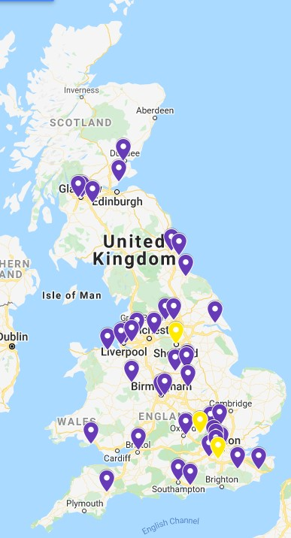
UPDATE: Sites Open
42 open
4 in set-up (yellow dots)
We have sites open around England, Wales & Scotland

Slide 6
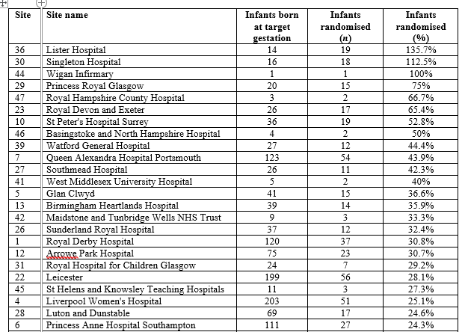
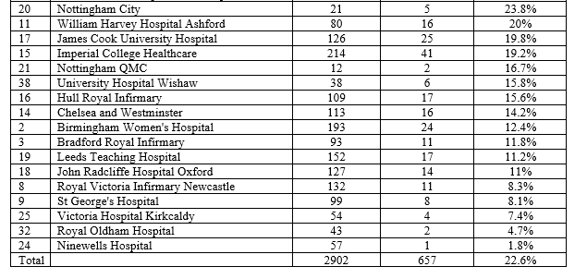
Recruitment
extension TBC*!
657 infants
(10/1/2022)
Update: Recruitment (%)
Av. Conversion: 34%
NB: Infants randomised can be higher than those born at gestation because the infants randomised figures are ‘live’ and therefore up-to-date, the infants born at target gestation are based on monthly screening logs

Slide 8
Discussion
Recruitment

Slide 9
Recruiting with a Range of Clinical Needs
A large range of babies have been successfully recruited
Birthweight
Range | 800-2500g
<10th Centile | 77 (12%)
Respiratory support at randomisation
No | 141 (22%)
Yes | 491 (78%)
*Mechanical ventilation | 45 (9%)
*Positive airways pressure | 345 (70%)
*High flow oxygen | 91 (19%)
*Other oxygen | 30 (6%)
Infant temperature on admission
Range | 35.7-39.2°c
Mean | 36.9°c ± 0.5
How do you feel about randomising different types of babies?
Infant worst base excess (24hrs of birth)
Range | -37-21.6
Mean | -3.6 ± 4.1
IV fluids started prior randomisation
No | 312 (48%)
Yes | 344 (52%)

Slide 10
Recruiting with Hypoglycaemia
40% of FEED1 babies glucose <2.2mmol
Blood Glucose: 1.6
How do you manage this situation
Start IV fluid whilst waiting randomisation
Randomised to full milk arm
Larger volumes
Hourly feeds
Continue IV fluid until blood sugar improved
Get baby on full milk, safely, as soon as possible

Slide 11
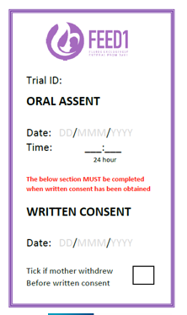
Recruitment Top Tips
1. Word Wisdom
3. Gain Oral Assent
It’s not that scary!
The FEED1 website has useful guides to help you feel confident with this (Health Care Professionals – Training)
Try to get oral assent within 1 hour of delivery
Be gently persistent – let mothers know the time constraints
“Early bonding”
“Trials”
“Study”
“Benefit”
“Comparison”
“Experimenting”
“If we knew the best feeding regime to use on your baby now we would use it – hence we need the study ”
“computer helps choose the option without any bias, or personal views”
“Computer decides”
“Increase the rate of establishing breast feeding”
2. Size Matters!
4. Team Talk
Regularly AND clearly identify eligible mothers during handovers & to staff in the delivery suite:
direct emails to staff
ask mothers to remind staff
use the oral assent sticker on file notes, even if written consent alone is taken (you can put a line through the Oral Assent section)
Divide the roles; e.g., one staff member randomises the baby whilst one staff member follows care procedures
The best recruiting sites have ≥7 people in their assent, consent and randomising team
Train everyone - registrars, ANNPs & middle grade staff to take assent, consent & randomise at start of rotation/induction
Min. training is on the FEED1 website (Health Care Professionals- Training):
Trial background
Trial design and outcomes
Trial processes and procedures

Slide 12
Recruiting Using Oral Assent
54% of infants in the study were now recruited by oral assent
Oral assent is growing in popularity in the FEED1 trial
More infants are now recruited into the study by oral assent from the mother before obtaining written informed consent
Our top recruiting sites use oral assent
Our website has useful tools to support with oral assent
The business card you recently received has a QR code that links to the website animation to view with parents
How do you manage oral assent at your site
How do you train your staff to feel confident in the oral assent process

Slide 13
Discussion
Adherence

Slide 14
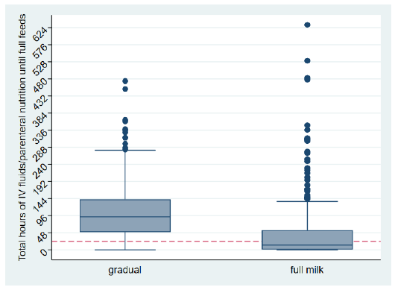
Protocol Adherence
Babies in full milk arm can have brief periods of IV fluids: Baby will be adherent to full milk arm if they receive ≤24 hours of IV until they reach 140ml/kg/d for 3 consecutive days
Full milk feed compliance: received ≤24 hours IV fluids or parenteral nutrition from birth to achieving full milk feeds (defined as at least 140 ml/kg/day for three consecutive days).
Gradual milk feed compliance: received >24 hours IV fluids or parenteral nutrition from birth to achieving full milk feeds (defined as at least 140 ml/kg/day for three consecutive days).
Birthweight | Across Trial Arms (n=594*)
Total IV fluids until full feeds | 52 hrs
Adherent to trial intervention | 475 (80%)
*Infants who have reached full feeds

Slide 15
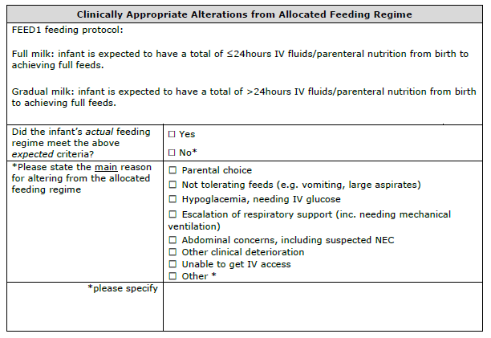
Protocol Adherence
New database form
Email alert if infant does not adhere to the allocated feeding regime
Complete the form
Consider if you can make changes in the future that puts the infants needs first, but still enables adherence to the allocated feeding regime

Slide 16
Discuss Strategies for Protocol Adherence
Respiratory distress
Large vomits
Continue IV fluids, no full feeds until extubated
Continue feeds – babies vomit!!
Reduce total feeds
Put back on full milk feeds
Smaller volume, frequent feeds (e.g. hourly)
Try smaller feeds and build back to full milk over the next few feeds
Halve IV fluids and build back up to full feeds over 2-3 days
Blood Glucose: 1.6
Discussed earlier – any other suggestions?

