Slide 1
A randomised controlled trial of full milk feeds versus intravenous nutrition with gradual feeding for preterm infants (30⁺⁰ to 32⁺⁶ weeks gestational age)
Notes:
Welcome to the introduction to the FEED1 trial. In the next few minutes, we will take you through some background information about the trial and a brief review of the existing studies that have looked at this important research question.

Slide 2
Research question
Population | Infants born at 30⁺⁰ – 32⁺⁶ weeks gestation
Intervention | Full milk feeds from day one
Comparator | Parenteral nutrition/intravenous fluids with gradual milk feeding as per usual local practice
Primary outcome | Length of hospital stay
Notes:
FEED1 is a multicenter, open, parallel, randomised controlled superiority trial investigating the research question: will feeding full milk feeds from the first day of life to infants born at 30 to 32 weeks gestational age reduce their length of hospital stay as compared to the current practice of giving parenteral nutrition or intravenous fluids with gradual milk feeding.
More details of the trial design, and outcomes are described in other slides shows in this series.

Slide 3
Trial background
Notes:
Here we will review the background literature.

Slide 4
Prematurity in the UK
7% of all birth in the UK
Estimated annual total cost of prematurity = £2,48 billion
Burden of
care immediately after birth
ongoing health needs
long term problems (health, educational and social care costs)
Notes:
About 7% of babies born in the UK are premature i.e. born before 37 completed weeks of gestation. Premature births are estimated to cost billions of pounds – this includes the cost of immediate care of the preterm infant, their ongoing long term health needs, and the not-unsubstantial, associated educational and social care costs. There is therefore a need to find ways in which we can improve care of preterm infants with interventions that could improve quality care, improve long term outcomes, and simultaneously reduce the burden and cost of care for families, and health and social care systems.

Slide 5
Target population
Number of live birth
Completed weeks of gestation at birth
Data source: Office for National Statistics; Birth Characteristics 2015-17
Notes:
In the UK, babies born at <34 weeks gestational age are routinely admitted to neonatal units due to their prematurity.
The image here shows on the Y-axis the number of life births in England and Wales in 2015,16, and 17. The X-axis shows the number of completed weeks of gestation. It is clear from this graph that most babies born preterm are born at the higher gestations. Despite this most research in neonatal medicine is focused on the extremely premature babies who make up a very small number of our patients.

Slide 6
Target population
11% of all preterm births
42% of infants <34 weeks gestation
Number of live birth
Completed weeks of gestation at birth
Data source: Office for National Statistics; Birth Characteristics 2015-17
Notes:
In fact, of all the babies routinely admitted to neonatal units for prematurity, over 40% are born at 30,31, or 32 weeks of gestation. Recent large neonatal feeding trials have provide evidence for optimal enteral feeding practices for more premature infants. There is very little investigation to find better ways to feed the more mature among the preterm babies.
In the FEED1 trial, we aim to find the optimal way to provide nutrition to this large group. Findings of this trial would potentially impact care of a huge number of babies and their families.

Slide 7
Health need
Why this research is important?
Large number of infants and families that could benefit
Reduction in length of hospital stay
Reduced number of painful interventions
Reduction in risk of infection
BLISS coordinated feedback from parents
- outcomes and normalisation of care are very important
A reduction in length of hospital stay could:
Enhance family wellbeing through greater involvement in the care of their infants
Increase the availability of cots
Reduce cost of care
Notes:
The potential benefits of early feeding include reduced need for painful procedures such as placement of interavenous lines to give fluids or parenteral nutrition, a reduction in infection risk, early milk feeding with promotion of breast feeding all culminating into a possible reduction in the time babies have to stay in the hospital.
We discussed the research idea with parents of premature infants. Our research partner Bliss, UK largest charity for sick and premature infants, coordinated a parent survey where we received nearly 250 responses and parents told us that spending fewer days in hospital was very important to them and on their advice we chose this to be the primary outcome of the FEED1 trial.
Reduction in hospital stay could also, potentially, help neonatal service delivery by increasing availability of cots and reducing the cost of care.

Slide 8
Reduce
infections
painful procedures
Reduce
Hospital stay
Save costs
Increase efficiency
Notes:
With these in mind, we believe that full milk feeds from day 1, if found to be effective in the FEED1 trial, could improve care of preterm infants, help them get home sooner, and reduce cost of care for a large number of preterm infants.

Slide 9
Evidence base
6 RCTs
601 infants
All from India
Stable infants between 1000-1500 grams birth weight
Notes:
We looked at the existing literature to see if others have performed similar studies. A Cochrane systematic review of the FEED1 research question found 6 small but similar randomised controlled trials. All these studies were conducted in India – a country where the patient population and health care delivery is significantly different to that in the UK.

Slide 10
Evidence base
Notes:
Meta-analyses for outcome length of hospital stay showed that full milk feeds from day 1 reduces that number of days babies need to stay in the hospital. However, it is important to note that length of hospital stay in these studies was much shorter, at about 2 weeks, that in the UK which, for babies of 30-32 weeks is known to be 35-40 days. This means that although the result of this meta-analysis is encouraging, a UK study is required to investigate if this intervention can reduce length of hospital stay in our set up.

Slide 11
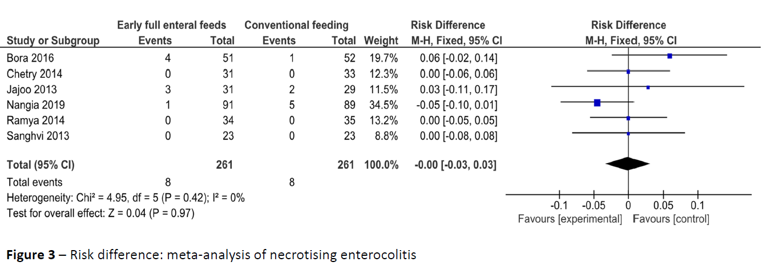
Evidence base
Notes:
The meta-analysis also looked at risk of necrotising enterocolitis, and it is reassuring to see that there is no difference in the risk of NEC between the groups although the total number of babies included in this analysis is not sufficient to confirm this.

Slide 12
Need for the trial
Uncertainty about how to feed the “not so immature” infants
Small studies conducted in a different setting
Potential to improve care of large number of infants and families
Potential to reduce cost of care
Need to ensure it is clinically feasible and safe
Notes:
There is a lack of evidence to support optimal feeding strategies for infants born at 30-32 weeks. These infants are usually grouped with more immature infants and fed too slowly due to the higher risk of NEC in the more immature population. Some small studies have investigated if full milk feeds from day 1 can be given but the studies include too few infants and have been conducted in health care settings that is quite different to the UK. Full milk feeds from day1 could potentially to improve care for a large number of infants and their families while simultaneously reduce the cost of care. However, it is important to ensure that this intervention is clinically feasible, and will provide the intended benefits before any practice change can be recommended. The FEED1 trial will answer this question.

Slide 13
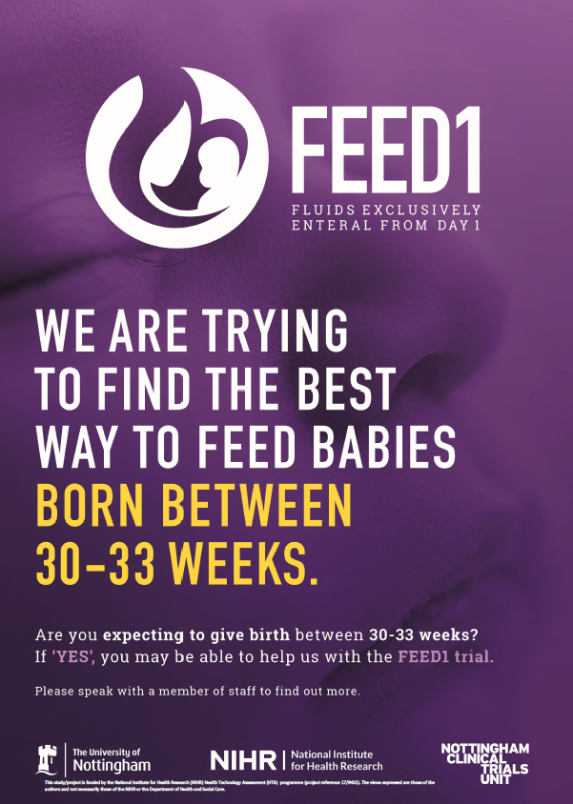
Further information
Contact us:
feed1@nottingham.ac.uk
Twitter: @FEED1Trial
Website: www.feed1.ac.uk
shalini.ojha@nottingham.ac.uk
Twitter: @shaliniojha7
Notes:
For further information, please see other slides sets in this series. You can find out more about the trial by contacting us using any of the above.

