Slide 1
Recruitment and Eligibility

Slide 2
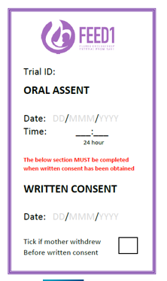
Recruitment Top Tips
1. Word Wisdom
3. Gain Oral Assent
It’s not that scary!
The FEED1 website has useful guides to help you feel confident with this (Health Care Professionals – Training)
Try to get oral assent within 1 hour of delivery
Be gently persistent – let mothers know the time constraints
“Early bonding”
“Trials”
“Study”
“Benefit”
“Comparison”
“Experimenting”
“If we knew the best feeding regime to use on your baby now we would use it – hence we need the study ”
“computer helps choose the option without any bias, or personal views”
“Computer decides”
“Increase the rate of establishing breast feeding”
2. Size Matters!
4. Team Talk
Regularly AND clearly identify eligible mothers during handovers & to staff in the delivery suite:
direct emails to staff
ask mothers to remind staff
use the oral assent sticker on file notes, even if written consent alone is taken (you can put a line through the Oral Assent section)
Divide the roles; e.g., one staff member randomises the baby whilst one staff member follows care procedures
The best recruiting sites have ≥7 people in their assent, consent and randomising team
Train everyone - registrars, ANNPs & middle grade staff to take assent, consent & randomise at start of rotation/induction
Min. training is on the FEED1 website (Health Care Professionals- Training):
Trial background
Trial design and outcomes
Trial processes and procedures

Slide 3
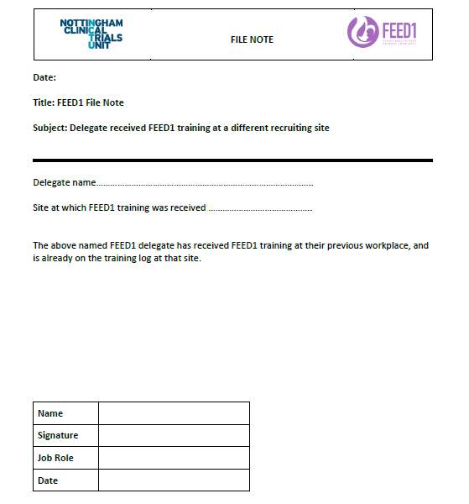
Training Staff
How much training is required at minimum?
https://www.feed1.ac.uk/health-care-professionals/training.aspx
Trial background
Trial design and outcomes
Trial processes and procedures
Further training to help with oral assent is also on the website
What do we do if someone has been trained at a different hospital?
Get in touch with the trial team (feed1@nottingham.ac.uk) – we then provide a file note
Add individual to the new hospital’s delegation log as usual

Slide 4
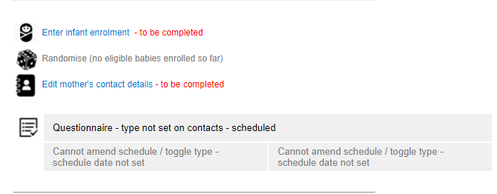
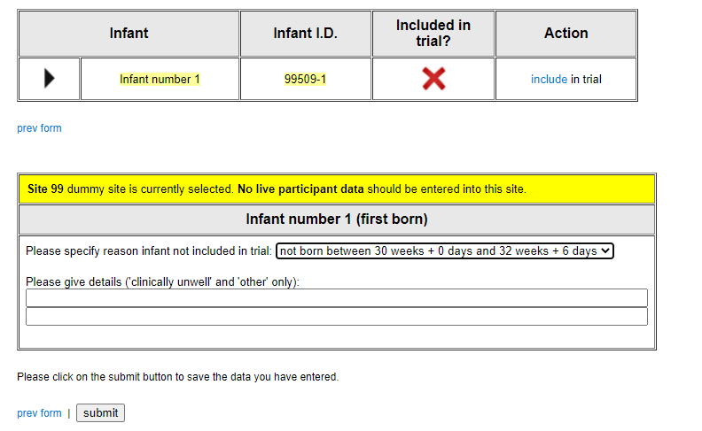
Add Consented Mothers to the Rando System
All mothers who consent should be added to the rando system
This reduces the work/time pressures when a baby is delivered – you only then need to enter infant details
If a baby is delivered outside of the target gestation you simply note this:
Step 1: Select Enter infant enrolment
Step 3: Specify the reason not included and submit
If you have not been doing this, please start! But you do not have to go back and add consenting mothers retrospectively
Step 2: Under ‘Action’ click exclude from trial

Slide 5
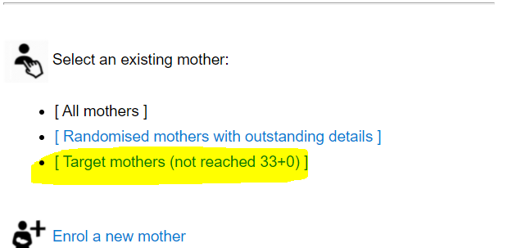
Tracking Consented Mothers During Staff Handovers
Use this report to save time during randomising and improve handovers
A report is available in the randomisation system
We recommend you print screen and disseminate this to staff so they know who has consented in the system and is ready to randomise after delivery.
We recommend you use this during handover to out-of-hours staff and/or weekend cover.
Please make use of this report to best suit your site’s needs – we would like to hear about how you use it!
Step 2: Mothers consented, but not randomised
Step 1: Select Enter Target mothers

Slide 6
Gaining Consent from Mothers who do not Speak English
If you have a hospital interpreter, or someone who can translate for you, we suggest you use this option.
The primary outcome is length of hospital stay, as such to obtain this information we do not need the mother to provide any written information.
The mother needs to be able to understand the purpose and procedures of the trial.
Inclusivity is important when possible!

Slide 7
Recruiting a Range of Infants
A large range of babies have been successfully recruited
Birthweight
Range | 800-2500g
<10th Centile | 132 (12%)
Respiratory support at randomisation
No | 228 (21%)
Yes | 843 (79%)
*Mechanical ventilation | 62 (7%)
*Positive airways pressure | 585 (69%)
*High flow oxygen | 178(21%)
*Other oxygen | 52 (6%)
Infant temperature on admission
Range | 7-39.2°c
Mean | 36.9°c ± 1.1
How do you feel about randomising different types of babies?
Infant worst base excess (24hrs of birth)
Range | -37-11.1
Mean | -3.7 ± 3.9
IV fluids started prior randomisation
No | 539 (50%)
Yes | 545 (50%)
Data taken from Oct 2022

Slide 8
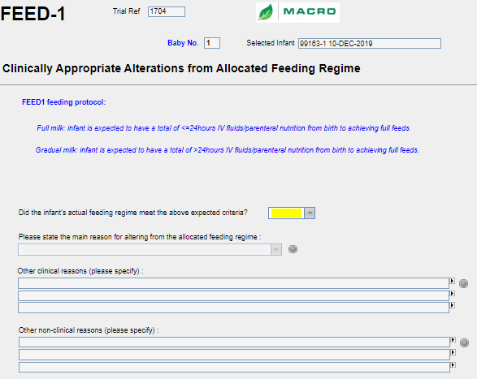
Concerns that Treatment Allocation will not be Adhered to
Clinically appropriate alterations from the allocated feeding regime
If an infant is unable to follow the allocated treatment regime, this
does not result in a protocol deviation.
The protocol allows for changes from the feeding regime based on clinical judgement; the baby’s needs come first.
When alterations are made for a valid clinical reason, this is fully compliant with the protocol.
To record these reasons you will soon receive a CRF which allows you to record your clinical rationale for altering from the allocated feeding regime.
The protocol allows for changes from the feeding regime based on clinical judgement; the baby’s needs come first.
Notes:
It is possible that infants allocated to a feeding arm may not be adherent to the assignment. For example an infant in the full milk arm may not tolerate the milk volumes, or may have hypoglycaemia requiring intravenous glucose. In all such situations, infants must be treated as per their clinical needs which must take priority over any trial protocols.
An infant will be considered to be compliant to full milk arm if they have received ….
Similarly, an infant in the gradual milk arm will be considered adherent if they have receive ….
The data on adherence to treatment allocation will be reported for both groups but analyses will be as per the intention to treat principle.

Slide 9
Individual Reflection
Please share your ideas and best practice

Slide 10
Reflect on Your Site’s Recruitment and Conversion Rates
How does recruitment look at your site?
How does conversion from eligible infants to infants randomised look?

Slide 11
Infants Born at Target
Gestation
Infants Randomised n (%)
Infants Born at Target
Gestation
Infants Randomised n (%)
Hospital Name
Hospital Name
Site | Site name | Infants born at target gestation | Infants randomised (%)
30 | Singleton Hospital | 29 | 31 (106.9%)
36 | Lister Hospital | 44 | 39 (88.6%)
48 | Stoke Mandeville | 23 | 18 (78.3%)
44 | Wigan Infirmary | 14 | 9 (64.3%)
23 | Royal Devon and Exeter | 36 | 22 (61.1%)
47 | Royal Hampshire County | 19 | 11 (57.9%)
10 | St Peter's Hospital Surrey | 69 | 38 (55.1%)
27 | Southmead Hospital | 56 | 30 (53.6%)
29 | Princess Royal Glasgow | 59 | 30 (50.8%)
46 | Basingstoke and North Hamps | 19 | 9 (47.4%)
39 | Watford General Hospital | 40 | 18 (45%)
7 | Queen Alexandra Hospital Ports | 169 | 73 (43.2%)
1 | Royal Derby Hospital | 166 | 58 (34.9%)
38 | University Hospital Wishaw | 66 | 23 (34.8%)
42 | Maidstone & Tunbridge Wells | 35 | 12 (34.3%)
5 | Glan Clwyd | 65 | 22 (33.8%)
28 | Luton and Dunstable | 95 | 30 (31.6%)
12 | Arrowe Park Hospital | 87 | 27 (31%)
22 | Leicester | 262 | 81 (30.9%)
40 | Northwick Park Hospital | 27 | 8 (29.6%)
20 | Nottingham City | 41 | 12 (29.3%)
6 | Princess Anne Hospital | 138 | 38 (27.5%)
41 | West Middlesex University | 22 | 6 (27.3%)
13 | Birmingham Heartlands Hospital | 77 | 19 (24.7%)
11 | William Harvey Hospital Ashford | 111 | 27 (24.3%)
4 | Liverpool Women's Hospital | 265 | 64 (24.2%)
21 | Nottingham QMC | 41 | 9 (22%)
31 | Royal Hospital for Children Glasgow | 56 | 12 (21.4%)
50 | Epsom and St Helier Uni Hospital | 19 | 4 (21.1%)
15 | Imperial College Healthcare | 284 | 59 (20.8%)
17 | James Cook University Hospital | 162 | 32 (19.8%)
14 | Chelsea and Westminster | 155 | 28 (18.1%)
26 | Sunderland Royal Hospital | 74 | 13 (17.6%)
25 | Victoria Hospital Kirkcaldy | 74 | 12 (16.2%)
2 | Birmingham Women's Hospital | 244 | 37 (15.2%)
3 | Bradford Royal Infirmary | 118 | 17 (14.4%)
16 | Hull Royal Infirmary | 133 | 19 (14.3%)
9 | St George's Hospital | 127 | 15 (11.8%)
43 | The Jessop Wing - Sheffield | 43 | 5 (11.6%)
18 | John Radcliffe Hospital Oxford | 176 | 20 (11.4%)
19 | Leeds Teaching Hospital | 214 | 23 (10.7%)
45 | St Helens and Knowsley Teaching | 33 | 3 (9.1%)
8 | Royal Victoria Infirmary | 179 | 13 (7.3%)
24 | Ninewells Hospital | 96 | 5 (5.2%)
32 | Royal Oldham Hospital | 100 | 3 (3%)
This table does not account for date opened, some sites have been
recruiting longer than others.
Discrepancies in infants born at target gestation vs infants
randomised are due to delays in screening logs being uploaded
Data downloaded Oct 2022

Slide 12
What is the Local View on FEED1 Recruitment?
Are your team members happy to recruit babies at 30, 31, 32 weeks into the trial?
Are your team aware that babies who are small for their gestational age can be recruited if they don’t have reverse end diastolic flow?
Are your team happy to recruit babies on mechanical support such as CPAP or mechanical ventilation?
Are your junior doctors/ANNP(s) happy to recruit out of hours and overnight?
Do you have an adequate number of staff trained to take oral assent and randomise out-of-hours?

Slide 13
Equipoise Issues
Challenges within the team?
Birthweight
Mean birthweight of babies in the trial is 1615g
The range is 800g-2500g
12% of the sample are in the <10^{th centile} birth weight
Strong opinion formers reluctant to randomise?
Guidelines that conflict with the trial protocol?
Respiratory Support
Mechanical ventilation: 7% (n=62)
CPAP: 69% (n=585)
High flow: 21% (n=178)
Supplemental oxygen: 6% (n=52)
Heart rate >100 at 5 min: 95% (n=1013)
Worse base excess in first 24 hrs: -3.7 (Mean)
Could using the data presented here help?
Data collected Oct 2022

Slide 14
Who Makes Consent Approaches?
In your team – who….
Is responsible for identifying potential participants?
Actually has the conversation?
Is trained to deliver consent?
Is your consent/assent team too small?
Not enough hours in the day
Is your assent/consent team too large?
Hard to keep staff turnover covered

Slide 15
Oral assent
% Oral assent
Total consent
Oral assent
% Oral assent
Total consent
Site Name
Site Name
Royal Derby Hospital | 55 | 98 | 56
Birmingham Women’s Hospital | 25 | 36 | 70
Bradford Royal Infirmary | 7 | 35 | 20
Liverpool Women’s Hospital | 36 | 60 | 60
Glan Clwyd Hospital | 17 | 43 | 40
Princess Anne Hospital Southamp. | 32 | 67 | 48
Queen Alexandra Hospital Ports. | 56 | 85 | 66
Royal Victoria Infirmary Newcastle | 10 | 37 | 27
St George’s Hospital | 10 | 59 | 17
St Peter’s Hospital Surrey | 8 | 27 | 30
William Harvey Hospital Ashford | 16 | 50 | 32
Arrowe Park Hospital | 21 | 81 | 26
Birmingham Heartlands Hospital | 10 | 59 | 17
Chelsea and Westminster Hospital | 8 | 17 | 48
Imperial College Healthcare | 21 | 33 | 64
Hull Royal Infirmary | 11 | 61 | 18
James Cook University Hospital | 27 | 93 | 29
John Radcliffe Hospital Oxford | 10 | 53 | 19
Leeds Teaching Hospital | 19 | 70 | 27
Nottingham City Hospital | 7 | 39 | 18
Nottingham Queen's Medical | 9 | 43 | 21
Leicester Royal Infirmary | 47 | 57 | 82
Royal Devon and Exeter Hospital | 15 | 65 | 23
Ninewells Hospital | 2 | 50 | 4
Victoria Hospital Kirkcaldy | 6 | 43 | 14
Sunderland Royal Hospital | 5 | 45 | 11
Southmead Hospital | 25 | 81 | 31
Luton and Dunstable Hospital | 11 | 39 | 28
PRM, Glasgow | 21 | 81 | 26
Singleton Hospital, Swansea | 10 | 14 | 73
RHC, Glasgow | 8 | 53 | 15
Royal Oldham Hospital | 2 | 50 | 4
Lister Hospital | 24 | 71 | 34
University Hospital Wishaw | 4 | 17 | 24
Watford General Hospital | 2 | 13 | 16
Northwick Park Hospital | 7 | 78 | 9
West Middlesex | 4 | 67 | 6
Maidstone and Tunbridge Wells | 8 | 62 | 13
The Jessop Wing, Sheffield | 0 | 0 | 9
Wigan Infirmary | 3 | 38 | 8
St Helens and Knowsley | 1 | 50 | 2
Basingstoke and North Hampshire | 8 | 67 | 12
Royal Hampshire,Winchester | 4 | 50 | 8
Stoke Mandeville Hospital | 16 | 100 | 16
Epsom and St Helier | 2 | 50 | 4
Are You a Low Assent Site?
Is the assent/consent balance right for your site?
If not can you make any changes?

Slide 16
Lets Discuss
Recruitment Scenarios

Slide 17
Recruitment: Scenario 1
Would you approach this women for FEED1?
If yes, what is your plan for consent?
30+0 weeks gestation women
On antenatal ward
Currently well but has ruptured membrane
Received steroids as may deliver in next few days

Slide 18
Recruitment: Scenario 2
Would you approach this women for FEED1?
If yes, what is your plan for consent?
Women delivered at 31+0 weeks gestation one hour ago
No antenatal discussion on FEED1
Infant is eligible and you think suitable for FEED1

Slide 19
Recruitment: Scenario 3
Would you approach this women for FEED1?
If yes, what is your plan for consent?
32+1 week gestation woman
In labour suite awaiting C/S in a few hours
No fetal anomalies expected

Slide 20
Recruitment: Scenario 4
Would you approach this women for FEED1?
If yes, what is your plan for best management?
30+1 weeks gestation
Birth weight 1350 grams
2 hours old
Had surfactant, now on CPAP in 0.3 FiO₂

Slide 21
Recruitment: Scenario 5
Would you approach this women for FEED1?
If yes, what is your plan for best management?
31+3 weeks gestation
Birth weight 1700 grams
1 hours old
Ventilated in 0.50 FiO₂, on inotropes, antibiotics

Slide 22
Recruitment: Scenario 6
Would you approach this women for FEED1?
If yes, what is your plan for best management?
31+5 weeks gestation
Birth weight 1200 grams
No evidence of reversed diastolic flow
1 hour old
On high flow 5L/min FiO₂ 0.32

Slide 23
Recruitment: Reasons for Refusing to Participate
Do you ask why?
What reasons have you been given?
Did you know you can ask why?
Mothers don’t have to answer this question, but if they do it can be useful to find out their reasons

