Slide 1
How Can We Improve Questionnaire Follow-up Rates?

Slide 2
Why Are Follow-ups Important?
Important information on safety
Important information on efficacy
Increase effectiveness of research efforts

Slide 3
What do our Follow-up Rates Look Like?
6 weeks
70% Return rate
63% Completion rate
N=943
2 years
76% Return rate
(completion rates pending)
N=71
6 weeks
258: No response
11: Withdrawn consent
4: Died
2 years
11: No response
2: Died
1: Withdrawn consent

Slide 4
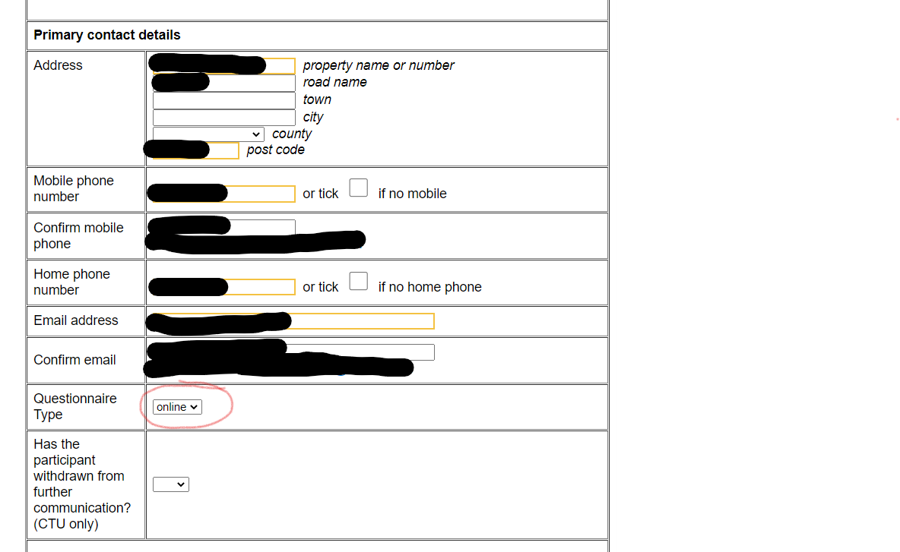
Encourage Online Completion
Collect email addresses
Double check addresses are correct

Slide 5
Use the Thank You Cards in the Red Book

Slide 6
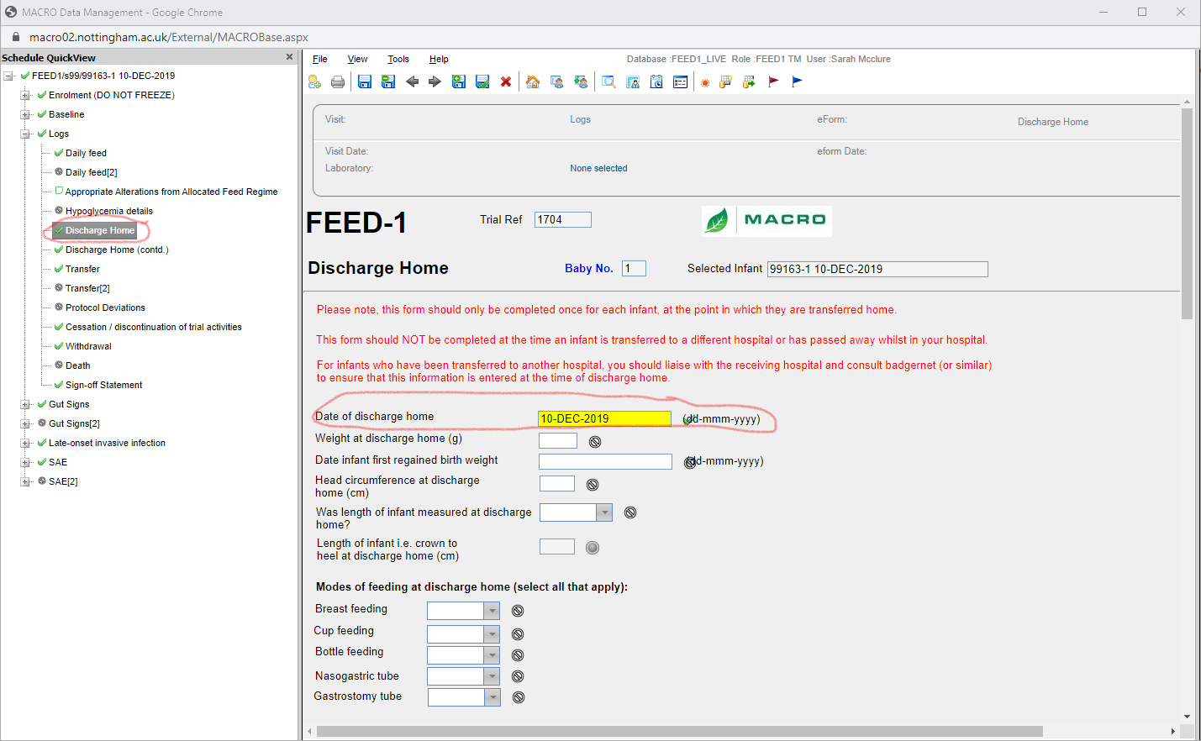
Complete the Discharge Date in Macro
We send different questionnaires if the infant hasn’t been discharged from hospital
We also send different questionnaires if the infant has died
Make sure discharge date is complete

Slide 7
Please fill the well-being checks in promptly
Let us know if it is difficult to get this information (eg. If the family have moved overseas, out of area, or no return visits)
We can mark as unavailable in the randomisation system if you let us know you are having difficulty – the parent can then be sent the questionnaire
Your emails will be saved as evidence that efforts that have been made to check the infant's status

