Slide 1
Protocol Adherence & Managing Conditions

Slide 2
What Does Adherence Mean in FEED1?
Full milk feed compliance:
received ≤24 hours IV fluids or parenteral nutrition from birth to achieving full milk feeds (defined as at least 140 ml/kg/day for three consecutive days).
Babies in full milk arm can have brief periods of IV fluids: Baby will be adherent to full milk arm if they receive ≤24 hours of IV until they reach 140ml/kg/d for 3 consecutive days
Gradual milk feed compliance:
received >24 hours IV fluids or parenteral nutrition from birth to achieving full milk feeds (defined as at least 140 ml/kg/day for three consecutive days).
Adherence rates: over both study arms, adherence remains stable at ~80%

Slide 3
What Does Adherence Look Like in the Full Milk Arm?
Example of Non-Adherence
These dates/figures are for illustrative purposes only
Full feeds reached
Day 1
Day 2
Day 3
Day 4
Day 5
Day 6
Non-Adherence in the Full Milk Arm: The infant has more than 24hrs (in total) of IV fluids from birth to reaching full feeds.
5 hrs
2 hrs
10 hrs
2 hrs
4 hrs
4 hrs
IV fluids: running total
7 hrs
17 hrs
19 hrs
23 hrs
27 hrs
Example of Adherence
Adherence in the Full Milk Arm: The infant has less than, or equal to 24hrs (in total, from birth to reaching full feed criteria) of IV fluids from birth to reaching full feeds.
Full feeds reached
7 hrs
3 hrs
0 hrs
1 hr
4 hrs
0 hrs
Iv fluids: running total
10 hrs
10 hrs
11 hrs
15 hrs
15 hrs
≥140ml/kg of full milk feeds or parental nutrition sustained for 3 consecutive days
Birth
Full feeds

Slide 4
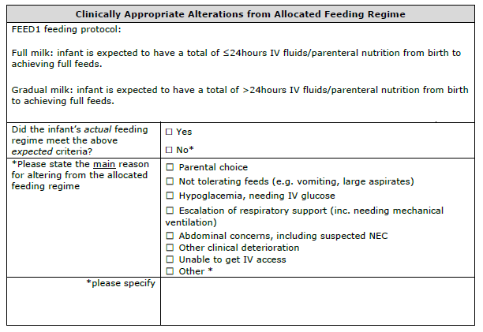
When Infants aren’t Adherent to the Feed Allocation
Email alert if infant does not adhere to the allocated feeding regime
Complete this form
Consider if you can make changes in the future that puts the infants needs first, but still enables adherence to the allocated feeding regime
Do not remove the infant from the trial
Do not complete the protocol deviation form

Slide 5
Protocol Deviations in the FEED1 Trial: We Have Two!
We only have TWO! Nothing else goes in this form
Anything else!
(examples below)
Entry of incorrect randomisation data
Why? This may affect stratification
Example: Wrong birth weight entered
Infant is given IV fluids in the full milk feeds group
What to do: complete the clinically appropriate alterations to allocated feeding regime form.
If (e.g.) this is due to hypoglycaemia then also complete this form
2. Incorrect intervention mistakenly given to the infant
Example: The infant is randomised to full feeds but mistakenly given gradual milk feeds
Note: This is different to a clinical decision being made to alter the allocated feeding regime
Infant is not tolerating feeds
What to do: complete the clinically appropriate alterations to allocated feeding regime form
Infant is transferred to another hospital
What to do: complete the infant transfer pack

Slide 6
Managing Hypoglycaemia
Pre-Randomisation:
Start IV fluid whilst waiting randomisation
Randomised to full milk arm:
You can give first full milk feed quickly
Give IV fluids to stabilise blood glucose, then try partial enteral feeds, gradually
building up to full feed over the next few days
Try larger volumes of feeds (if tolerated)
Try more frequent feeds (e.g. hourly)
Get baby on full milk, safely, as soon as possible

Slide 7
How do you manage hypoglycemia?

Slide 8
Managing Feed Intolerance
Continue feeds – babies vomit!!
Reduce total feeds volume if blood glucose not a concern and gradually increase volumes again to full requirements
Smaller volume, frequent feeds (e.g. hourly)
Halve IV fluids and build back up to full feeds over 2-3 feeds

Slide 9
How do you manage feed intolerance?

Slide 10
Managing Respiratory Support
Try smaller feeds and build back to full milk over the next few feeds
Put back on full milk feeds when stable on ventilator
Continue IV fluids, no full feeds until extubated if otherwise unwell
Infants receiving mechanical intervention can have full milk feeds, their airways are protected

Slide 11
How do you manage escalation of respiratory support?

Slide 12
Managing Suspected NEC
Stop full milk feeds
Complete the NEC case report form
Dealing with Suspected NEC and LOS from a FEED1 Perspective
How? Blinded End Point Review Committee (BERC)
Why? Reduce potential bias in clinical evaluations
All cases reviewed by 2 independent reviewers
If agreement can't be reached a 3rd reviewer will be asked to evaluate the case

Slide 13
Any further comments or experiences to share?

