Slide 1
A randomised controlled trial of full milk feeds versus intravenous nutrition with gradual feeding for preterm infants (30⁺⁰ to 32⁺⁶ weeks gestational age)
Clinical scenarios for training Asking for consent
1

Slide 2
Research question
Population | Infants born at 30⁺⁰ to 32⁺⁶ weeks gestation, inclusive
Intervention | Full milk feeds from day one
Comparator | Parenteral nutrition/intravenous fluids with gradual milk feeding as per usual local practice
Primary outcome | Length of hospital stay

Slide 3
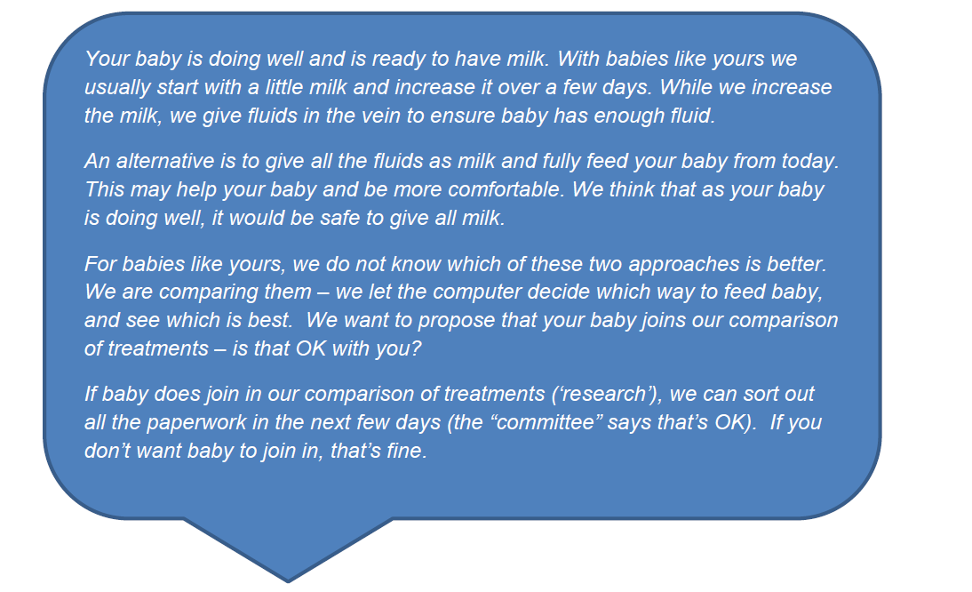
Training resources

Slide 4
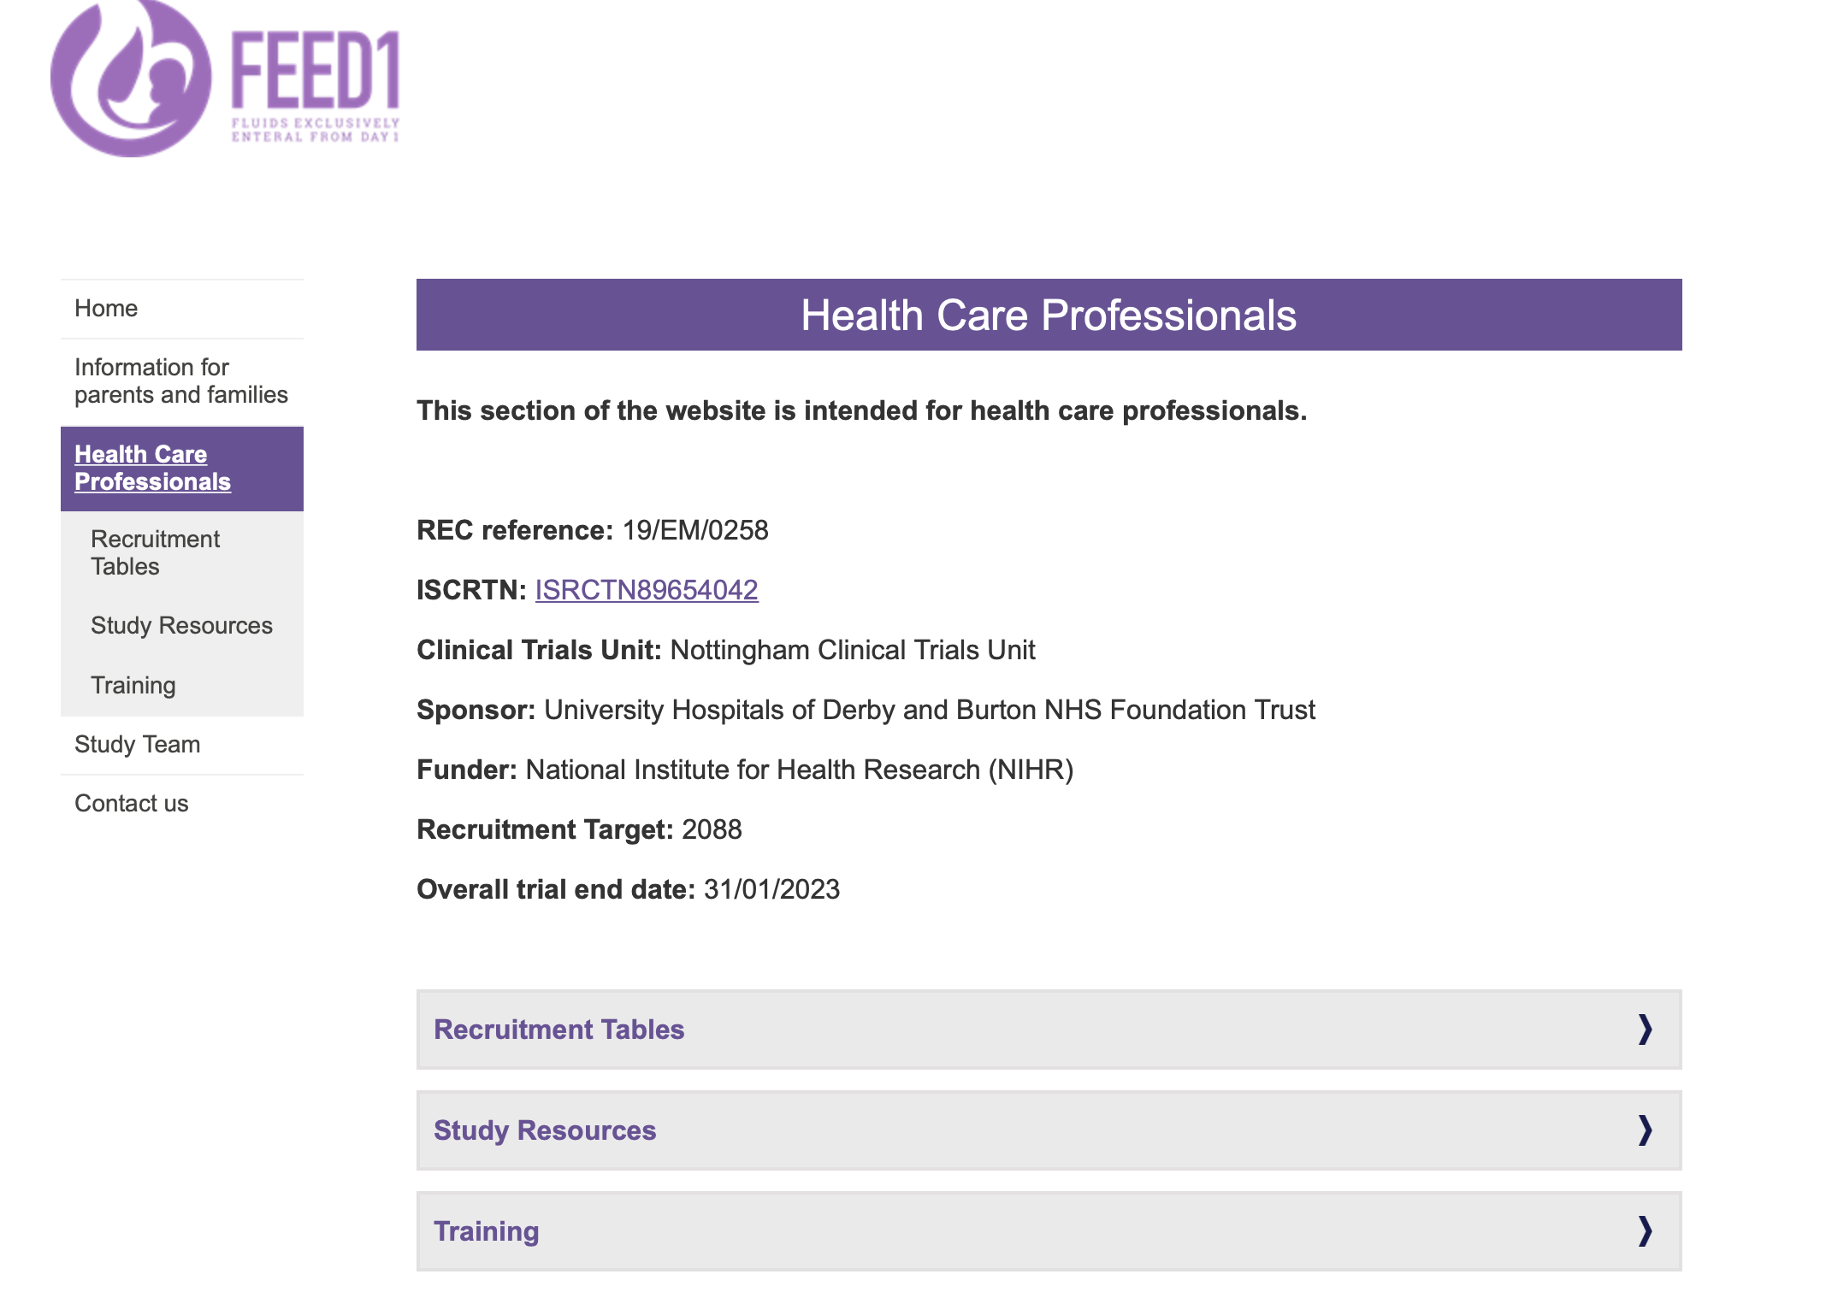
Training resources
Notes:
On the feed1 website, go to the Health care professionals page and then to the Training tab – there are 4 example conversation videos on this page
Click on the screen shot to go to that page.

Slide 5
Consent scenarios 1
30+0 weeks gestation women
On antenatal ward
Currently well but has ruptured membrane
Received steroids as may deliver in next few days
Would you approach this women for FEED1?
If yes, what is your plan for consent?

Slide 6
Consent scenarios 1 - answers
30+0 weeks gestation women
On antenatal ward
Currently well but has ruptured membrane
Received steroids as may deliver in next few days
Consider
There is time to take written informed consent
If written consent is given, women’s details can be entered into the randomisation website
Randomisation can be done as soon as baby is born and considered eligible.

Slide 7
Consent scenario 2
Women delivered at 31+0 weeks gestation one hour ago
No antenatal discussion on FEED1
Infants is eligible and you think suitable for FEED1
Would you approach this women for FEED1?
If yes, what is your plan for consent?

Slide 8
Consent scenario 2 - answers
Women delivered at 31+0 weeks gestation one hour ago
No antenatal discussion on FEED1
Infants is eligible and you think suitable for FEED1
Consider – perfect for ORAL ASSENT pathway!
Explain study verbally
If women agrees to participate, sign the oral assent section at the back of the consent form and ask a witness to sign with you.
Randomise!

Slide 9
Consent scenario 3
32+1 week gestation woman
In labour suite awaiting C/S in a few hours
No fetal anomalies expected
Would you approach this women for FEED1?
If yes, what is your plan for consent?

Slide 10
Consent scenario 3
32+1 week gestation woman
In labour suite awaiting C/S in a few hours
No fetal anomalies expected
Consider
You may take full written consent if there is time and woman is comfortable
Oral assent may be more appropriate
If woman agrees to participate, sign the oral assent section at the back of the consent form and ask a witness to sign with you
Randomisation can be done as soon as baby is born and considered eligible.

Slide 11
Key considerations
Oral assent can be taken in the antenatal period or after baby is born
Preferred pathway for unexpected deliveries and when taking consent in the immediate postnatal period
You can use the video or the short information flyer to help the conversation but using these is NOT mandatory
Giving verbal information is sufficient for oral assent.

Slide 12
Key considerations
MUST sign the oral assent section of the consent form (see back of the consent form)
MUST obtain a witness signature
Witness is
someone who saw and heard you take oral assent from the women
anyone present – any staff, women’s family or friend

Slide 13
Key considerations
If oral assent is given before the baby is born
No need to confirm assent after birth
Randomise the woman as soon as eligibility of the baby is confirmed.

Slide 14
Key considerations
Full written informed consent MUST be taken before baby is discharge or transferred from the unit.
Ideally, ask the women to give the written consent within 3 days of delivery.

Slide 15
Summary of information needed for oral assent

