Slide 1
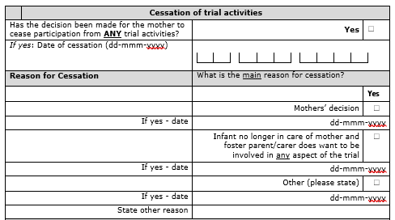
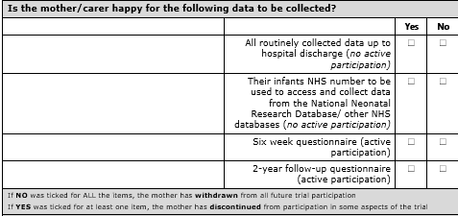
What to do if a Mother wants to Cease Participating in FEED1
What do you need to do? Fill in the Cessation of Trial Activities Form
When? If a mother wants to withdraw from any aspect of the trial
When not? If a clinical decision has been made to alter from the allocated feeding arm – in this instance please complete the ‘Clinically Appropriate Alterations from Allocated Regime” form.
How? Complete the form with the mother and enter the responses on to Macro/database
1. Please Check :
What parts of the trial does the mother want to stop participating in?
If the Mother want to stop actively participating in the trial (e.g. completing any forms/questionnaires), are they happy for their infant(s) to stay in the trial and the trial team can still collect routine hospital data about their baby?
Please make it clear, their infant can remain in the trial without them having to do anything! We can still collect some useful data from hospital records
2. Complete the Cessation of Trial Activities form with the mother
If the mother selects no to all items they have been withdrawn from all future trial participation.
Data that has already been collected can not be withdrawn (see the Participant Information Sheet)

