Slide 1
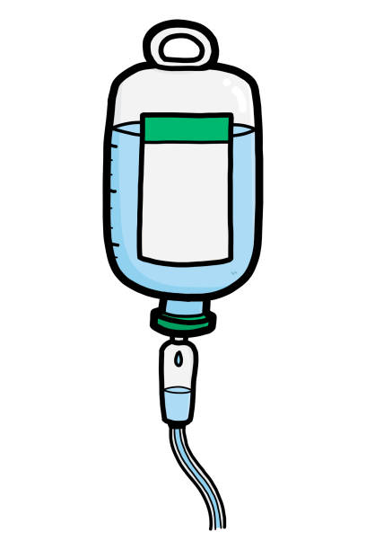
What Does Adherence Look Like in the Full Milk Arm?
Example of Non-Adherence
These dates/figures are for illustrative purposes only
Full feeds reached
Day 1
Day 2
Day 3
Day 4
Day 5
Day 6
Non-Adherence in the Full Milk Arm: The infant has more than 24hrs (in total) of IV fluids from birth to reaching full feeds.
5 hrs
2 hrs
10 hrs
2 hrs
4 hrs
4 hrs
IV fluids: running total
7 hrs
17 hrs
19 hrs
23 hrs
27 hrs
Example of Adherence
Adherence in the Full Milk Arm: The infant has less than, or equal to 24hrs (in total, from birth to reaching full feed criteria) of IV fluids from birth to reaching full feeds.
Full feeds reached
7 hrs
3 hrs
0 hrs
1 hr
4 hrs
0 hrs
Iv fluids: running total
10 hrs
10 hrs
11 hrs
15 hrs
15 hrs
≥140ml/kg of full milk feeds or parental nutrition sustained for 3 consecutive days
Birth
Full feeds

